Slide 1

Water Security through Stewardship
An Action Platform of the CEO Water Mandate (2018 – 2020)
Draft: September 2017
CONFIDENTIAL

Slide 2
Agenda
2:00 PM – Welcome and Introduction
2:10 PM – Overview of the CEO Water Mandate and Transition to an Action Platform
2:30 PM – Discussion Around the Overarching Structure and Objectives
2:45 PM - Action Platform Focus Areas & Activities in 2018
3:40 PM – Expected Outcomes
3:55 PM – Next Step Wrap-up and Adjourn

Slide 3







CEO Water Mandate
Objective
To mobilize a critical mass of business leaders to address global water challenges through corporate water stewardship, in partnership with the United Nations, governments, civil society organizations, and other stakeholders
CONFIDENTIAL
DIRECT OPERATIONS
SUPPLY CHAIN
AND WATERSHEDS
COLLECTIVE ACTION
PUBLIC
POLICY
COMMUNITY ENGAGEMENT
TRANSPARENCY AND DISCLOSURE

Slide 4


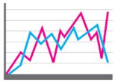
CEO Water Mandate 2016-2018 Strategic Plan
CONFIDENTIAL
GOALS | Support Achievement of 2030 Sustainable Development Goal 6: Sustainable Management and Access to Water and Sanitation for All
 | Support Endorsers’ Commitments to the Mandate’s Six Core Elements
WORKSTREAMS |  | Operations, Supply Chain and Watershed Management |  | Collective Action, Community Engagement, and Public Policy |  | Transparency and Disclosure
 | The Water Stewardship Toolbox Supply Chain Working Group |  | Best Practices for Effective Collective Action on Water Integrity in Water Stewardship Initiatives |  | Harmonized Corporate Water Reporting Alignment with SDG6 Impact Metrics
SUPPORTING FUNCTIONS | Strategic Planning and Partnerships
 | Project and Working Group Facilitation
 | Technology and Communications
 | Events
 | Governance and Accountability
 | Recruiting and Fundraising

Slide 5
CONFIDENTIAL
CEO Water Mandate
Objective of the Working Groups
Working groups develop tools, guidance, projects, work with experts, and align with SDG6 to support Mandate endorsers’ efforts to meet commitments for water stewardship
Mandate endorsers join to contribute to thought leadership, share best practice, and shape new projects
.
DIRECT OPERATIONS
SUPPLY CHAIN
AND WATERSHEDS
COLLECTIVE ACTION
PUBLIC
POLICY
COMMUNITY ENGAGEMENT
TRANSPARENCY AND DISCLOSURE

Slide 6
Overview of Current Working Group Structure
CONFIDENTIAL
CEO Water Mandate
Working Groups and Projects
Human Rights
and WASH
Operations and Supply Chain Stewardship
Metrics, Impact,
and Disclosure
Collective Action and Policy Engagement
WASH 4 WORK
Water Stewardship Toolbox
Context-Based Metrics
Water Action Hub 2.0
WASH in the Supply Chain
Linking Impacts to SDG6
Business Alliance for Water and Climate
California Corporate Water Stewardship
Existing Tools
and Guidance
Guidance for Companies on Respecting the Human Rights to Water and Sanitation
Water Stewardship Toolbox
Corporate Water Disclosure Guidelines
Discussion Paper on Establishing Context-Based Water Targets
Water Action Hub
Guide to Water-Related Collective Action
Guide to Managing Integrity in Water Stewardship Initiatives
Framework for Responsible Business Engagement with Water Policy
SDG6 Targets
6.1 Drinking water
6.2 Sanitation and hygiene
6.3 Water quality
6.4 Water efficiency, scarcity, and balance
6.5 Integrated management
6.6 Water-related ecosystems
6.a Cooperation and capacity-building
6.b Local communities

Slide 7
Background: UNGC Programmatic Restructuring
CONFIDENTIAL
With the restructuring of the UN Global Compact’s Programmatic Activities, the issues area work is being transformed, including the work of the CEO Water Mandate
Programmatic work will be organized into four pillars as noted below

Slide 8
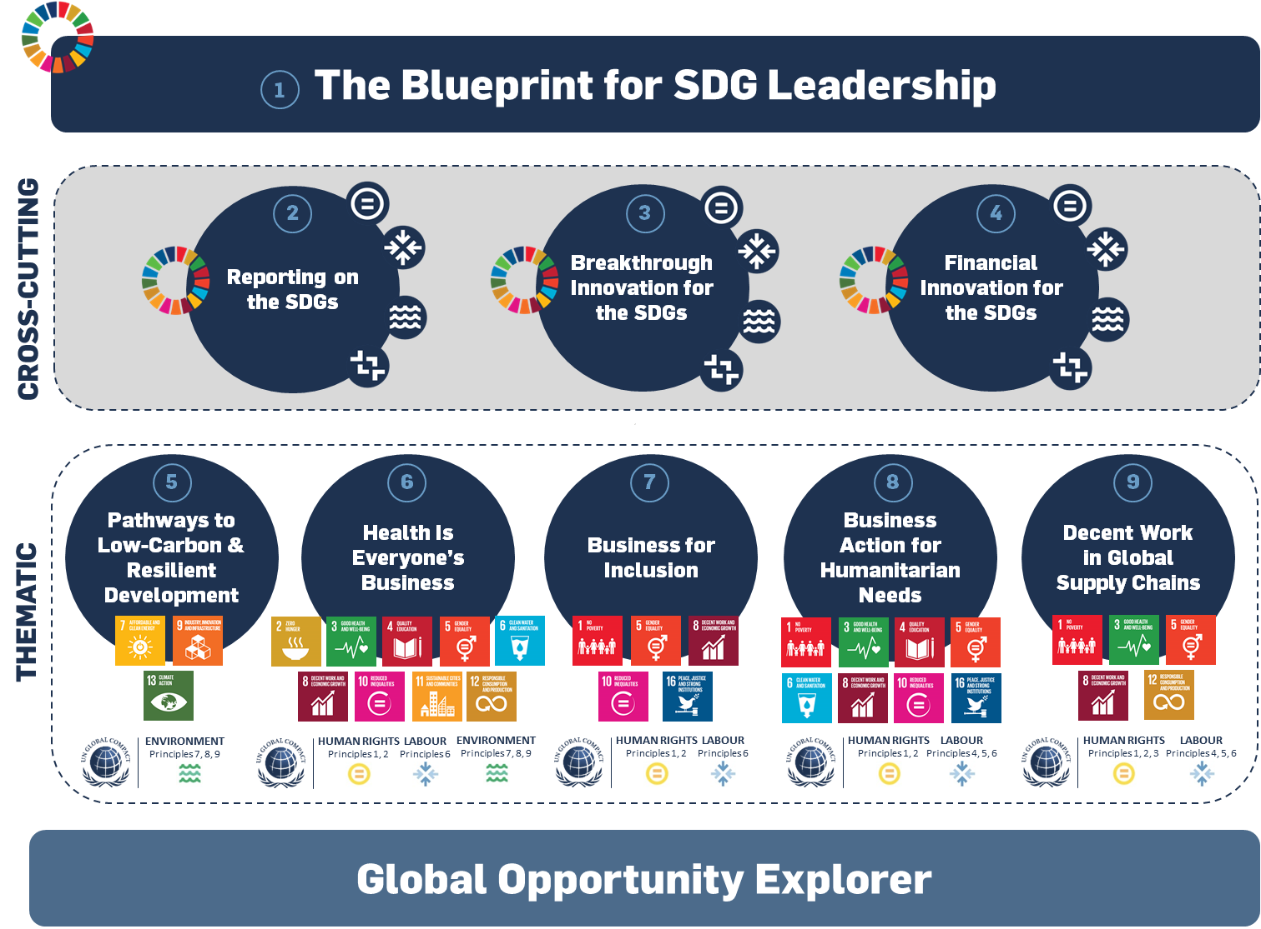
Background: Current Suite of Action Platforms
CONFIDENTIAL

Slide 9
About Global Compact Action Platforms
CONFIDENTIAL
Main component of the Global Compact’s 2020 Strategy and primary way we will engage leading companies (expectations for 20-40 companies per action platform)
Expectation that outcomes of the Action Platforms will be shared with all participants of the UNGC, to engage the whole base of companies
Designed to allow companies to help define leadership practices and enable collective action on the SDGs.
Activities are designed to run for 1-3 years producing a set of specific outcomes
Design to provide value to participants in the areas of:
  Definition of future practices in corporate sustainability
  Access to a network of leading companies, experts and various stakeholders
  Guidance on enhancing the integration of sustainability into corporate business planning
  Contributions to key UN, international and national processes on sustainable development

Slide 10
Key Changes to Branded Initiatives
CONFIDENTIAL
Remains in the Branded Initiative | Reconfigured – To be Aligned with the Action Platforms
Commitment Areas | Governance and Strategic Direction
Multi-stakeholder Convening and Related Events | Programmatic Work Project Partnerships Development of Knowledge Products
Existing Partnerships with Core Partners

Slide 11
UNGC Programmatic Restructuring and the CEO Water Mandate
CONFIDENTIAL
What Stays the Same?
The six commitment areas of the Mandate will remain the same and is open to existing and new endorsing companies
Communications on Progress-Water (COP-Water) remains the same for all Mandate endorsers
The Mandate will continue to convene its annual working conference during Stockholm World Water Week, and it will be open to all Mandate endorsers as will regional meetings

Slide 12







What’s New: An Action Platform on Water
CONFIDENTIAL
Action Platform for 2018:
Water Security Through Stewardship
10

Slide 13
CONFIDENTIAL
Key Changes: Mandate’s Substantive Work Program and Governance will Occur within the Action Platform
Workstreams: All current workstreams of the CEO Water Mandate (and their corresponding working groups) will be transitioned over to the water stewardship Action Platform.
  WASH and Human Rights
  Direct Operations and Supply Chain
  Indicators, Metrics, and Disclosure
  Collective Acton and Policy Engagement
Membership to the working groups will only be open to Action Platform participants, all Action Participants must be Mandate Endorsers
Governance: Steering Committee members will be derived from the Action Platform participants keeping in place the geographic diversity as outlined by the current TOR for the Steering Committee
Important note: All leadership thinking, guidance, and best practices will be shared widely with endorsing companies, regardless of whether they are in the Action Platform, in order to benefit the full endorser base

Slide 14
Value of participation
CONFIDENTIAL
By participating in this platform, companies will be able to:
Be on the leading edge of water stewardship practice, addressing critical social, economic, and environmental aspects of water and sanitation
Develop, pilot test, and implement cutting-edge guidance and tools that help address pressing water and sanitation challenges globally
Work jointly on collective action and partnership opportunities on improve water security in water stressed regions
Engage with policy makers and scope out solutions that support broader policy outcomes on water and sanitation
Engage in cross-sectoral peer learning on water-related risks, challenges, and solutions

Slide 15
Proposed Water Action Platform Objectives
CONFIDENTIAL
The Water Security Through Stewardship Action Platform brings together companies, UN entities, governments, NGOs, and other stakeholders to:
Mobilize business action by both leaders and learners to adopt increasingly more advanced water stewardship practices that tackle all dimensions of water and sanitation.
Work with leading companies to test, refine, and scale cutting-edge water stewardship practices, including setting context-based water targets, pioneering WASH solutions, and innovating climate resiliency measures.
Develop a global framework and foster local partnerships, collective actions, or policy engagements that advance more sustainable water management in support of SDG6 and its touchpoints with other SDGs; and develop systems to measure contributions and outcomes.
Contribute to efforts underway by the UN Global Compact to track business contributions in support of SDG6 and embed water and sanitation into other relevant Action Platforms.

Slide 16
Platform Elements
CONFIDENTIAL
Goal and Key Aspects | Support achievement of Sustainable Development Goal 6 and its impact on other SDGs
 | Facilitate effective, impactful, and equitable collective actions and public policy engagement
 | Increase uptake of good water stewardship practice by companies of all types and sizes
Elements | Building Capacity of Learners and Leaders | Facilitating On-the Ground Collective Action | Developing Metrics and Reporting
 | Develop tools, resources, and guidance that help enable greater adoption of water stewardship practice across environmental, social, and economic realms Prioritize, implement and scale basic water stewardship for farms and facilities for Local Network companies and others to move along the stewardship progression | Foster cross sectoral coalitions to implement place-based projects across thematic areas Engage in policy discussions to reinforce the role that water stewardship plays for meeting the SDGs. | Develop guidance and test the implementation of context-based metrics and water targets Develop metrics to measure the impacts of water stewardship collective actions Contribute to efforts to track business contributions to SDG6 and its touchpoints with other SDGs

Slide 17
Human Rights and WASH
Focus on water access, sanitation, and hygiene (WASH) in the workplace, supply chain, and communities where companies operate.
Continuation of flagship projects WASH4WORK and WASH in the Supply Chain.
2018 Activities include:
Scoping good practice guidance for promoting WASH in the supply chain and begin its development
Incubate pioneering WASH practices with 2-3 groups of companies in strategic regions of interest
Release and undertake targeted outreach around a study on making the business case for WASH investments
Develop a consensus document elucidating connections between WASH and stewardship
Explore potential for integration of WASH in sustainability standard systems
Joint activity with the International Labor Organization to implement WASH@work toolkit
Host a series of high-profile strategic events including at World Water Forum 2018, High Level Political Forum, and Stockholm World Water Week to advance and showcase business contribution to the WASH agenda

Slide 18
Metrics, Impacts, and Disclosure
Focuses on exploring opportunities to set targets and report real-world impacts of water stewardship collective actions that improve the health of at-risk watersheds.
Flagship project is context-based water targets.(CBWT)
Activities include:
Develop and pilot test a context-based approach with companies and establish a project advisory group to provide technical and strategic guidance
Host strategic events and webinars with industry associations and other stakeholders to raise awareness and refine thinking on CBWT best practice
Lead multi-stakeholder discussions geared toward aligning corporate water stewardship frameworks/metrics/measurement systems with SDG6 and other water-related SDGs
Develop and test collective action impact metrics and their alignment with SDG6 and national/local government policy objectives
Notes:
This working group focuses on exploring opportunities to set targets and report real-world impacts that improve the health of at-risk watersheds in order to contribute to SDG6 on water quality and water efficiency, scarcity, and balance.
Our flagship project is developing a guidance for context-based water targets. Since mid-2016, the CEOWM has been working in partnership with CDP, TNC, WRI and WWF to assist businesses to align their water use with public policy objectives and a scientific understanding or local river conditions. Through collaboration with multi-stakeholders, we aim to recommend an approach to universal and meaningful context-based water metrics and targets they support.
We are still in the early stages of what we hope to achieve. We have gathered feedback from stakeholders, and are on our second round of revisions to the Discussion Paper, which we plan to release in April. Going forward, the group aims to develop a guidance document to advise companies on how to set CBWTs.
This working group is one way to engage in the work to ensure that the CBWT work is applicable to companies, add value to the work that’s already been done (e.g., the BIER’s context based target setting), and receive the company’s inputs when developing an approach to set CBWT.
The key activities in 2017 is to develop a guidance for the CBWT to identify gaps and improve utility.
Furthermore, we’ll continue to lead discussions and share information geared towards aligning key corporate water stewardship frameworks/metrics with SDG6 in order to bring the public and private sector perspectives together. This year the CEO Water Mandate will be part of the UN Water Expert working group on monitoring and reporting to track SDG6.

Slide 19
Collective Action and Policy Engagement
Focuses on facilitating stewardship partnerships and exploring opportunities to work together across public, private, and nonprofit sectors locally and internationally
Flagship projects include Business Alliance for Water and Climate (BAFWAC) and the California Water Action Collaborative (CWAC)
Newly launched apparel industry-focused initiative led by Mandate-endorsing brands
Activities include:
Develop a web platform highlighting business best practice on water and climate
Host strategic events at Stockholm Water Week, World Water forum, and CDP’s report launch in India on climate-resilient supply chains to raise awareness around water and climate
Work within BAFWAC to bring corporate perspectives to UNFCCC discussions and the Global Climate Action Agenda
Map joint apparel sector locations and analysis of current water stewardship tools and resources as applicable to the apparel sector
Develop a metrics framework to evaluate the impact and efficacy of CWAC on-the-ground partnerships (cross linked with Metrics working group)

Slide 20
Engagement at the Local Level – From Learners to Leaders
Expand water stewardship to key geographies through engagement with UNGC Local Networks (LNs)
Develop “water stewardship playbooks” and personalized engagement opportunities with Local Networks to help companies of all sizes on water stewardship journey
Catalyze and support partnerships with Local Networks in Latin America, Africa, and Asia, particularly where Mandate endorsing companies have operations, suppliers, or other strategic interests, and where local capacity exists to broker and administer water stewardship initiatives.
Activities include:
Identification and engagement with key LNs where there is a strategic interest and local capacity. General outreach and awareness raising (i.e., stewardship playbooks) to be pursued across the UNGC network
Current LNs identified for deep levels of engagement include South Africa and Brazil. Development of personalized strategies on water stewardship for local context
Notes:
. Touch upon this quickly…
As the UNGC implements its 2020 Strategy and launches its action platforms, we’ll be looking to ensure that water is integrated across the portfolios. Will continue the direction of the initiative to work with local networks in key geographies to further water stewardship, particularaly looking at Brazil where the World Water Forum 2018 will be held as well as in India and S. Africa.
We’ll also be looking to scale stewardship through our work with development agencies – most notably we’re a partner in the USAID’s Sustainable Water Partnership that focuses on water security and where we’ll bring a stewardship component.

Slide 21
Tools Development for Operations and Supply Chain Stewardship
Focus on bringing water stewardship to farms, manufacturing, and enterprises of all sizes.
Flagship project is the Water Stewardship Toolbox – connecting businesses to over 160 resources that help them advance water stewardship.
Activities include:
Expanding tools, best practices, case studies, guidance, and more on Toolbox
Integrating Toolbox with Water Action Hub
Building issue-and-initiative-specific portal(s)
Curated content and guidance in the Toolbox
Working with Mandate endorsers to test and promote the Toolbox
Expansion of WAH to include projects and organizations working on operations and supply chain engagement, among other aspects of the journey

Slide 22
Activities Timeline – to be refined
 | 2017 |  |  |  | 2018 -2020
ACTIVITY | April | August | September | Q4 2017
Consultation with Mandate SC and Endorsers Official announcement of new AP on water and consultation UNGC Leaders Summit (September 21, 2017) Scoping of platform activities and official launch of AP on water Develop and implement engagement opportunities with key UNGC Local Networks Develop resources and tools for socializing corporate water stewardship via the Water Stewardship Toolbox Collective Action and Policy Engagement by Industry Sector or Issue Develop indicators, metrics, and disclosure for impact Further Scale WASH and Stewardship Activities

Slide 23
Key Expected Outputs & Outcomes
Outputs:
The launch of a new portals and tools building on from the Water Stewardship Toolbox for socializing water stewardship good practice
The launch of guidance around Context Based Water Targets and a number of pilots
The development of collective action impact metrics for local water stewardship initiatives
The implementation of the apparel sector initiative including a supply chain analysis and management tool and local collective action opportunity
Engagement and documentation of activities on water and climate as well as WASH by leading companies
Outcomes
Increased uptake of water stewardship in a number of key geographies by companies new to stewardship through use of the Mandate’s tools and resources
Prove context based water targets through pilots and adoption of the methodology by a number of action platform companies.
Increased uptake of WASH, climate, and water activities including increased documentation around the evidence for business interventions on the themes
Better understanding of how to measure the impacts of local water stewardship initiatives
Notes:
Slide 25 on outcomes of the platform. Perhaps it is the strategy (under promise and over deliver) but in my mind they are framed relatively safely as outputs rather than outcomes.
For example, for the cbwt one it reads:
The launch of guidance around Context Based Water Targets and a number of pilots
I think are more committed outcome may be that by 2020 the action platform would have:
Along with other partners help prove cbwt setting methodology through pilots, with the resultant guidance published and adopted by a number of action platform companies. Wording could be simplified but my point is more that all of the points reads as outputs rather than outcomes.
For the toolbox, I think a great outcome would be increase awareness and use/downloading of water stewardship tools available to support private sector action. Could have clear metrics to measure this. The work Peter is doing on the website undoubtedly will facilitate this.

Slide 24
Appendix
CONFIDENTIAL

Slide 25
Participation Fee
CONFIDENTIAL
In addition to the Global Compact annual contribution, Water Action Platform participants will be requested to pay a platform participant fee based on a company’s annual sales/revenue. This will replace the Mandate’s annual solicitation.
In 2018, the water stewardship platform will institute a transition year for current Mandate endorsers and sponsors
Levels of contributions made in 2017 will be maintained in 2018, though will transition to standard fee structure identified above in 2019.
In addition to Action Platform Participant Fees – endorsers will also be able to support water-related activities by sponsoring the Mandate’s multi-stakeholder conference held during Stockholm World Water Week. Event Sponsorship will be set at 30,000 US.
Annual Sales/Revenue (USD) | Water Action Platform Fee (Annual in USD) | Global Compact Mandatory Annual Contribution Fee (in USD)
> 5b | 20,000 | 20,000
1-5 b | 15,000 | 15,000
250 m – 1 b | 10,000 | 10,000
50 m – 250 m | 5,000 | 5,000
25-50m | 2,500 | 250
< 25 m | 500 | 500
Example: A company with annual revenues of 3 billion will need to make a 15,000 Annual contribution to the GCO and another 15,000 (on an annual basis) to join the Action Platform
Notes:
Ingvild

Slide 26
Patron Level Sponsorship
CONFIDENTIAL
While each sponsorship package is tailored to fit the needs of the specific patron sponsor, patron level sponsorship for the water stewardship platform is available for a USD 100,000 annual investment*:
- Each Action Platform offers up to four organizations the opportunity to assume a leadership position
Benefits:
Enjoy visibility on a global platform, among sustainability thought-leaders and experts
Logo/ name recognition in Action Platform specific media and promotional material and at all events and recognition in publications
Help shape strategic direction of the Action Platform
Patron Sponsorship Package also includes:
Use of Global Compact “We Support” logo.
Concierge relationship management to navigate and work with the UN Global Compact, Action Platforms and Local Networks.
Special and early invitations to UN Global Compact flagship events and programmatic events.
  Participation in high level convening of AP patrons, UNGC Board Members, and UN Heads during General Assembly week
First right of refusal for sponsorship renewal at the end of each calendar year.
*Please note this investment is in addition to Global Compact annual contribution,

