Slide 1

Water Security through Stewardship
An Action Platform of the CEO Water Mandate (2018 – 2020)
Draft: November 2017
Background of UNGC Restructuring and Fees
CONFIDENTIAL

Slide 2







CEO Water Mandate
Objective
To mobilize a critical mass of business leaders to address global water challenges through corporate water stewardship, in partnership with the United Nations, governments, civil society organizations, and other stakeholders
CONFIDENTIAL
DIRECT OPERATIONS
SUPPLY CHAIN
AND WATERSHEDS
COLLECTIVE ACTION
PUBLIC
POLICY
COMMUNITY ENGAGEMENT
TRANSPARENCY AND DISCLOSURE

Slide 3


CEO Water Mandate 2016-2018 Strategic Plan
CONFIDENTIAL
GOALS | Support Achievement of 2030 Sustainable Development Goal 6: Sustainable Management and Access to Water and Sanitation for All
 | Support Endorsers’ Commitments to the Mandate’s Six Core Elements
WORKSTREAMS |  | Operations, Supply Chain and Watershed Management |  | Collective Action, Community Engagement, and Public Policy |  | Transparency and Disclosure
 | The Water Stewardship Toolbox Supply Chain Working Group |  | Best Practices for Effective Collective Action on Water Integrity in Water Stewardship Initiatives |  | Harmonized Corporate Water Reporting Alignment with SDG6 Impact Metrics
SUPPORTING FUNCTIONS | Strategic Planning and Partnerships
 | Project and Working Group Facilitation
 | Technology and Communications
 | Events
 | Governance and Accountability
 | Recruiting and Fundraising

Slide 4
CONFIDENTIAL
CEO Water Mandate
Objective of the Working Groups
Working groups develop tools, guidance, projects, work with experts, and align with SDG6 to support Mandate endorsers’ efforts to meet commitments for water stewardship
Mandate endorsers join to contribute to thought leadership, share best practice, and shape new projects
.
DIRECT OPERATIONS
SUPPLY CHAIN
AND WATERSHEDS
COLLECTIVE ACTION
PUBLIC
POLICY
COMMUNITY ENGAGEMENT
TRANSPARENCY AND DISCLOSURE

Slide 5
Overview of Current Working Group Structure
CONFIDENTIAL
CEO Water Mandate
Working Groups and Projects
Human Rights
and WASH
Operations and Supply Chain Stewardship
Metrics, Impact,
and Disclosure
Collective Action and Policy Engagement
WASH 4 WORK
Water Stewardship Toolbox
Context-Based Metrics
Water Action Hub 2.0
WASH in the Supply Chain
Linking Impacts to SDG6
Business Alliance for Water and Climate
California Corporate Water Stewardship
Existing Tools
and Guidance
Guidance for Companies on Respecting the Human Rights to Water and Sanitation
Water Stewardship Toolbox
Corporate Water Disclosure Guidelines
Discussion Paper on Establishing Context-Based Water Targets
Water Action Hub
Guide to Water-Related Collective Action
Guide to Managing Integrity in Water Stewardship Initiatives
Framework for Responsible Business Engagement with Water Policy
SDG6 Targets
6.1 Drinking water
6.2 Sanitation and hygiene
6.3 Water quality
6.4 Water efficiency, scarcity, and balance
6.5 Integrated management
6.6 Water-related ecosystems
6.a Cooperation and capacity-building
6.b Local communities

Slide 6
Background: UNGC Programmatic Restructuring
CONFIDENTIAL
With the restructuring of the UN Global Compact’s Programmatic Activities, the issues area work is being transformed, including the work of the CEO Water Mandate
Programmatic work will be organized into four pillars as noted below

Slide 7
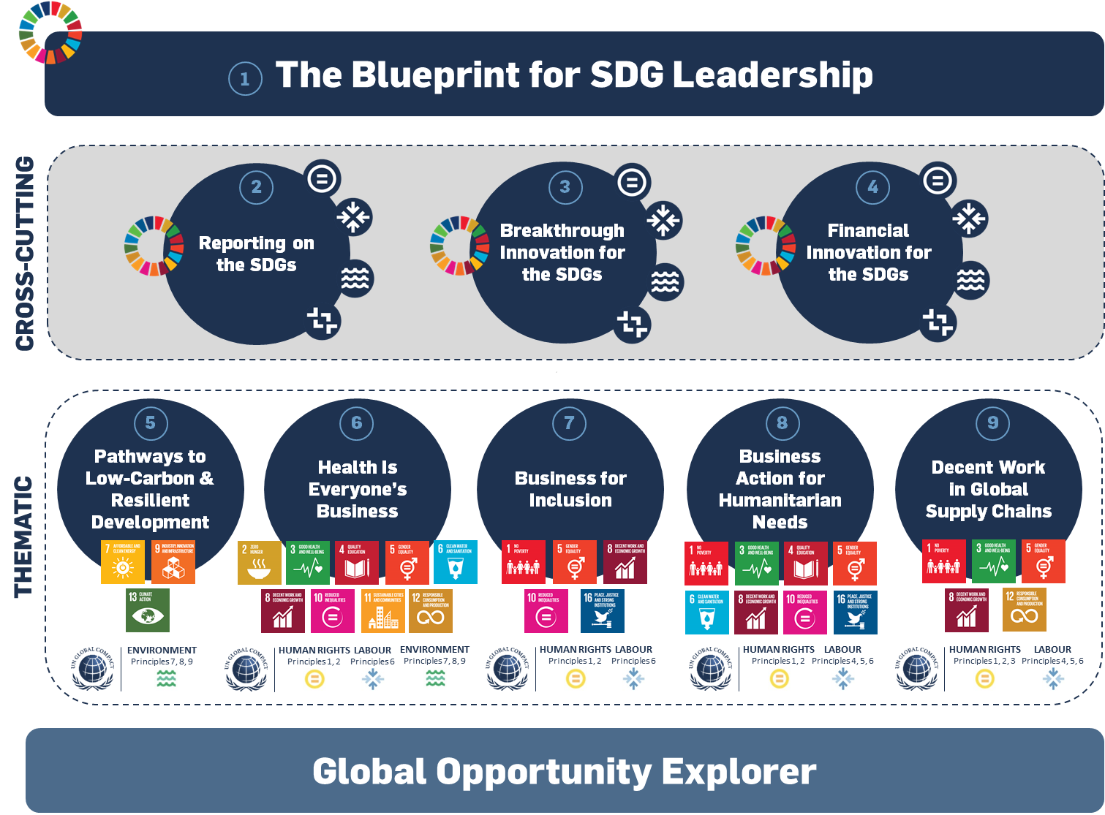
Background: Current Suite of Action Platforms
CONFIDENTIAL

Slide 8
About Global Compact Action Platforms
CONFIDENTIAL
Main component of the Global Compact’s 2020 Strategy and primary way we will engage leading companies (expectations for 20-40 companies per action platform)
Expectation that outcomes of the Action Platforms will be shared with all participants of the UNGC, to engage the whole base of companies
Designed to allow companies to help define leadership practices and enable collective action on the SDGs.
Activities are designed to run for 1-3 years producing a set of specific outcomes
Design to provide value to participants in the areas of:
  Definition of future practices in corporate sustainability
  Access to a network of leading companies, experts and various stakeholders
  Guidance on enhancing the integration of sustainability into corporate business planning
  Contributions to key UN, international and national processes on sustainable development

Slide 9
Key Changes to Branded Initiatives
CONFIDENTIAL
Remains in the Branded Initiative | Reconfigured – To be Aligned with the Action Platforms
Commitment Areas | Governance and Strategic Direction
Multi-stakeholder Convening and Related Events | Programmatic Work Project Partnerships Development of Knowledge Products
Existing Partnerships with Core Partners

Slide 10
UNGC Programmatic Restructuring and the CEO Water Mandate
CONFIDENTIAL
What Stays the Same?
The six commitment areas of the Mandate will remain the same and is open to existing and new endorsing companies
Communications on Progress-Water (COP-Water) remains the same for all Mandate endorsers
The Mandate will continue to convene its annual working conference during Stockholm World Water Week, and it will be open to all Mandate endorsers as will regional meetings

Slide 11







What’s New: An Action Platform on Water
CONFIDENTIAL
Action Platform for 2018:
Water Security Through Stewardship
10

Slide 12
CONFIDENTIAL
Key Changes: Mandate’s Substantive Work Program and Governance will Occur within the Action Platform
Workstreams: All current workstreams of the CEO Water Mandate (and their corresponding working groups) will be transitioned over to the water stewardship Action Platform.
  WASH and Human Rights
  Direct Operations and Supply Chain
  Indicators, Metrics, and Disclosure
  Collective Acton and Policy Engagement
Membership to the working groups will only be open to Action Platform participants, all Action Participants must be Mandate Endorsers
Governance: Steering Committee members will be derived from the Action Platform participants keeping in place the geographic diversity as outlined by the current TOR for the Steering Committee
Important note: All leadership thinking, guidance, and best practices will be shared widely with endorsing companies, regardless of whether they are in the Action Platform, in order to benefit the full endorser base

Slide 13
Participation Fee
CONFIDENTIAL
In addition to the Global Compact annual contribution, Water Action Platform participants will be requested to pay a platform participant fee based on a company’s annual sales/revenue. This will replace the Mandate’s annual solicitation.
In 2018, the water stewardship platform will institute a transition year for current Mandate endorsers and sponsors
Levels of contributions made in 2017 will be maintained in 2018, though will transition to standard fee structure identified above in 2019.
In addition to Action Platform Participant Fees – endorsers will also be able to support water-related activities by sponsoring the Mandate’s multi-stakeholder conference held during Stockholm World Water Week. Event Sponsorship will be set at 30,000 US.
Annual Sales/Revenue (USD) | Water Action Platform Fee (Annual in USD) | Global Compact Mandatory Annual Contribution Fee (in USD)
> 5b | 20,000 | 20,000
1-5 b | 15,000 | 15,000
250 m – 1 b | 10,000 | 10,000
50 m – 250 m | 5,000 | 5,000
25-50m | 2,500 | 250
< 25 m | 500 | 500
Example: A company with annual revenues of 3 billion will need to make a 15,000 Annual contribution to the GCO and another 15,000 (on an annual basis) to join the Action Platform
Notes:
Ingvild

Slide 14
Patron Level Sponsorship
CONFIDENTIAL
While each sponsorship package is tailored to fit the needs of the specific patron sponsor, patron level sponsorship for the water stewardship platform is available for a USD 100,000 annual investment*:
- Each Action Platform offers up to four organizations the opportunity to assume a leadership position
Benefits:
Enjoy visibility on a global platform, among sustainability thought-leaders and experts
Logo/ name recognition in Action Platform specific media and promotional material and at all events and recognition in publications
Help shape strategic direction of the Action Platform
Patron Sponsorship Package also includes:
Use of Global Compact “We Support” logo.
Concierge relationship management to navigate and work with the UN Global Compact, Action Platforms and Local Networks.
Special and early invitations to UN Global Compact flagship events and programmatic events.
  Participation in high level convening of AP patrons, UNGC Board Members, and UN Heads during General Assembly week
First right of refusal for sponsorship renewal at the end of each calendar year.
*Please note this investment is in addition to Global Compact annual contribution,

