Slide 1

MARKET SCAN

Slide 2
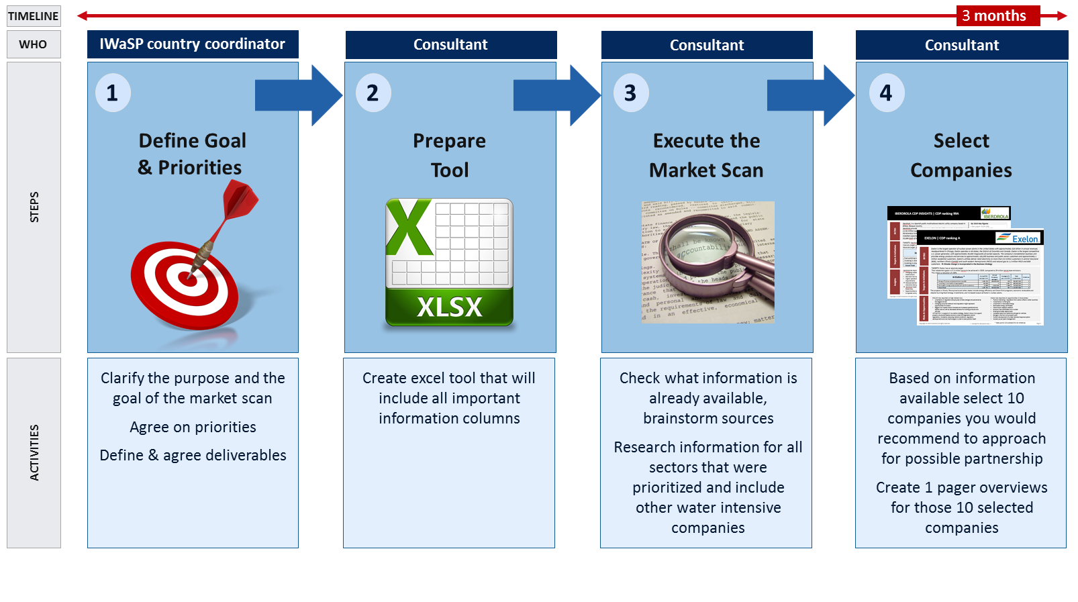


Market Scan
DESCRIPTION
Consolidated overview of all the relevant companies in your country including their water risks and water catchment locations to support proactive search and engagement with suitable potential partners for water stewardship activities.
HOW TO USE IT
Populate the Excel market Tool. Start from the sector/industry analysis and see who the main players are:
Companies within
prioritized sectors:
Agriculture
Mining
Beverages
Big companies
within your country
outside of
prioritized
sectors
Other
companies including
the local
companies
vulnerable to
water risks
MARKET SCAN
Complete
Overview

Slide 3
IWaSP Country Market Scan – HOW TO USE IT

Slide 4

The Objective of Market Scan
Why is Market Scan needed
OBJECTIVE
The objective of a Market Scan is to identify potential partners with water intensive businesses and partners facing water related risks with regard to water stewardship activities in order to enlarge your engagement with corporate partners.
Water Intensive industry sectors are highly dependent on water resources or highly vulnerable to water risks. Examples of vulnerability:
High quality water needed as a key input to production
Lot of water needed mainly for cooling or in-plant processes
Production of high volumes of wastewater
Discharging wastewater of high environmental significance
Long and complex supply chains with a high footprint
Having good understanding of what companies are present in your country and which ones have water intensive operations and/or are facing water risks will be an important asset when discussing potential engagement with governments and municipalities. Having this information will identify potentially vulnerable communities that need to be involved.
This can also serve as a market entry scan – however broader mapping (population, water basins, high level industry, economic & political situation) on country level will be required. Assumption for the following slides is to provide overview how the market can be explored once you or your institution is already set up in the country.

Slide 5
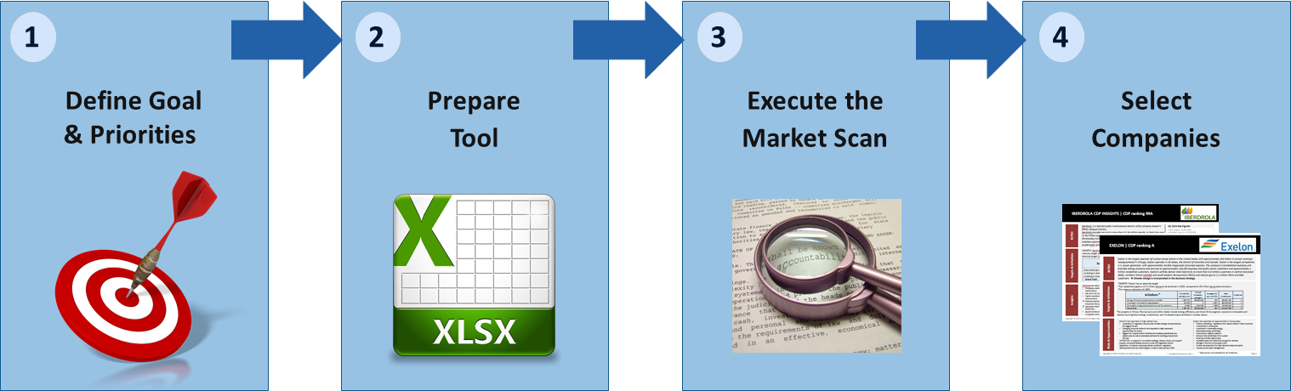



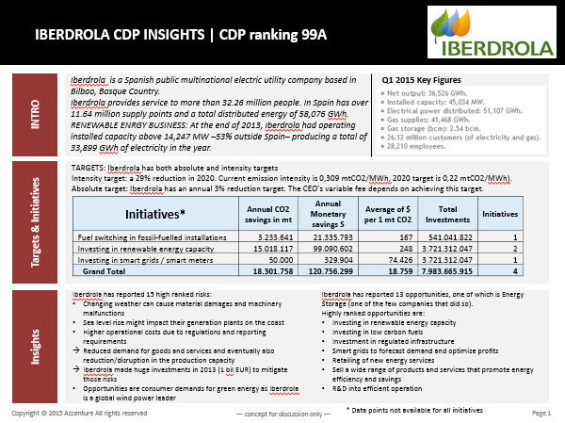
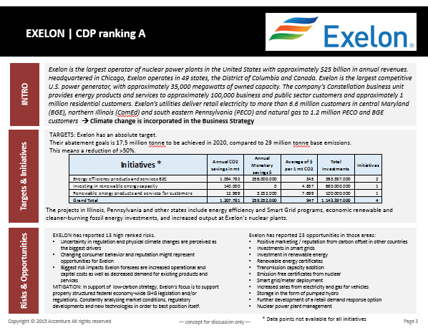
Market Scan Methodology
Steps & Activities for best results
TIMELINE
3 months
WHO
IWaSP country coordinator
Consultant
Consultant
Consultant
STEPS
Define Goal
& Priorities
Prepare
Tool
Execute the
Market Scan
Select
Companies
1
2
3
4
ACTIVITIES
Clarify the purpose and the goal of the market scan
Agree on priorities
Define & agree deliverables
Create excel tool that will include all important information columns
Check what information is already available, brainstorm sources
Research information for all sectors that were prioritized and include other water intensive companies
Based on information available select 10 companies you would recommend to approach for possible partnership
Create 1 pager overviews for those 10 selected companies

Slide 6
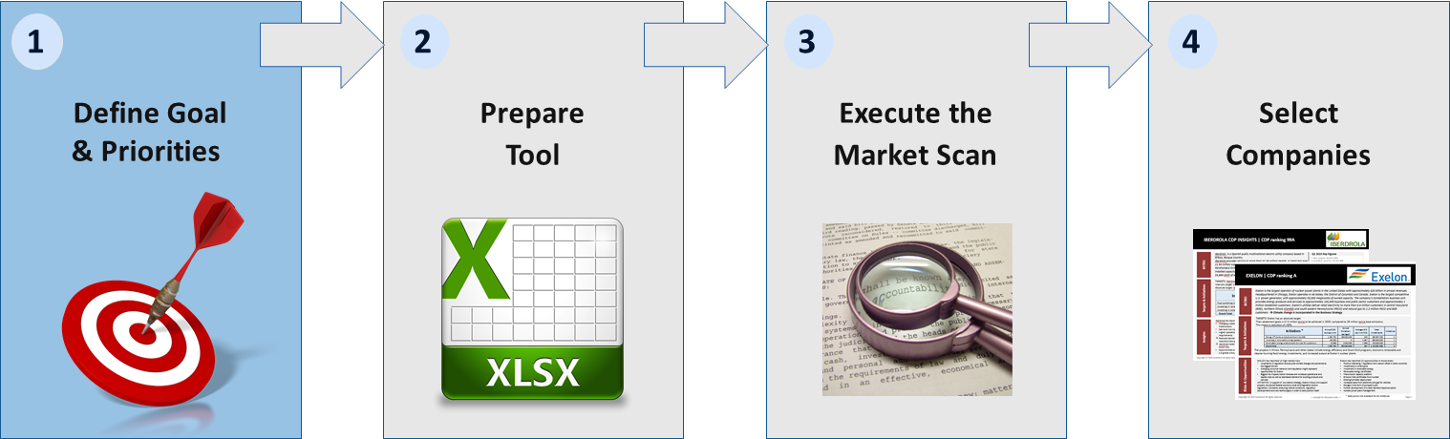
Define Goal & Priorities
1
Ensure understanding and the right focus
GOAL
The objective of a Market Scan is to identify potential partners with water intensive businesses and water risks with regard to water stewardship activities in order to enlarge the stewardship engagement with corporate partners.
EXPECTED RESULTS
Good overview of at least 50 different companies with the focus on the biggest and most water intensive ones or companies facing water risks. For each company consultant will do due diligence based on public data and existing contacts.
Overview will provide clear information regarding companies that will be used for creating links to public sector and communities.
DELIVERABLES
Completed Excel Market Scan tool
10 companies 1 Pagers
Clearly communicate the Goal, Expectations and Priorities to the team and to the consultant. Collect all relevant contacts and available information and share those with the consultant carrying out the Market Scan.
Notes:
Clarify the purpose of the market scan and set the goal → What is the reason the market scan is carried out?
What is the ideal results and what would this result consist of? What information is needed? Describe the ideal situation and see what is required to get there. What information is crucial?
PRIORITIES
Make sure that everyone understand this goal and everyone is aligned → Communicate this clearly also to the person responsible for the market scan.
Make sure that the focus of the Market scan is aligned with your strategy. If there are sectors that have been already identified as a priority (for instance agriculture, mining sector etc.) start the scan by researching those industries. See what relevant reports and documents are already available. Create a list of people that might be good to contact to discuss the sector or specific companies with.
Create overview of helpful data sources
Create a list of all the different data sources that might be helpful – include Annual reports, Sustainability report, Industry reports, different indexes, reports from different organization etc.
OVERVIEW:
Business operations
Risks and opportunities in regards to water
Stewardship maturity and resources
Water intensity information
Past, current and potential Water related engagements
Contacts on relevant people
Reference links

Slide 7
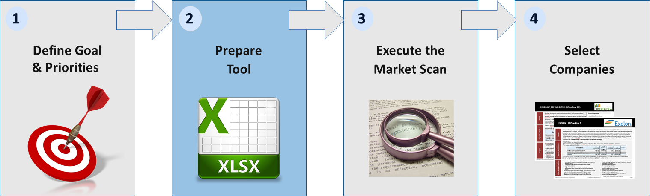
Prepare the Tool
2
Consultant will prepare a suitable Market Scan tool
EXCEL AS A SELECTED TOOL FORMAT
Excel should be used as a suitable tool.
CREATE THE TOOL
Consultant carrying out the Market Scan should be able to create a good Market Scan tool and present it to the country coordinator for approval.
DECIDE ON THE EVALUATIONS
Consultant should create different evaluation categories
and be clear on measurements.
EXAMPLE: Level of Sustainability Involvement
Market scan should provide clear information on:
  Company Name
  Industry
  Brief description of your business
  HQ location
  Location in your country
  Business focus in your country
  Revenue/GDP contribution
  Presence in other countries your are present
  Is their business here water intensive? (Yes/No)
  Water use (figure)
  River catchment /River Basin
  Level of Sustainability Involvement (Very High/High/Medium/Low)
  Prior Engagements with your institution (YES/NO and describe)
  Ongoing Initiatives & Water partnerships (describe)
  Sustainability Investments ( global/ Local & How much in $)
  Number of employees
  Any comments regarding their strategic goals/plans (Public Data and from available contacts))
  Potential Water Risks and Opportunities (describe, rating, where possible include the potential financial impacts and information on mitigation)
  Relevant Contacts (name/position/e-mail/phone number)
  GPS coordinates (link to google maps)
  Other comments & information
  Useful Links
Prior engagements, ongoing initiatives and information from media will serve as a due diligence and determine whether the company is a good fit for your strategy
Advantages of Excel:
  One consolidated view
  Same information collected for different companies → comparable
  Filtering on different columns
  Pivot tables building
  Easily adjustable
  Good basis for One pager
Very high → for companies well known for their Water programmes (e.g. listed in Dow Jones Sustainability Index, or high ranking in CDP)
High → company has a CSR report or dedicated CSR-site on its website
Medium → website shows the company is engaged in CSR-programs
Low → no information available on CSR-programs/ programs small
Notes:
Select the Categories
Person carrying out the Market scan should be able to create a good excel tool with all the needed information in columns. Suggested tool is excel.
Advantages of Excel:
One consolidated view
Same information collected for different companies which will make it comparable and give you better perspective
Excel overview will enable to filter on different categories
Option to create different views based on the information you want to see
Easy to add/change information/add column when needed
Good basis for One pager that can be included as a supporting documents for meeting preparation / presentation
Prior engagements, ongoing Initiatives and information from media will serve as a due diligence and determine whether the company is a good fit for your strategy
LEVEL OF SUSTAINABILITY:
Very high for companies that are globally renowed for their Water programmes (for example listed in Dow Jones Sustainability Index, or high ranking in other sustainability indexes e.g. CDP)
High if the company has a CSR report or dedicated CSR-site on its website
Medium if the corporate website shows the company is engaged in multiple CSR-programs
Low if there is no information available on CSR-programs or if the programs mentioned are relatively small

Slide 8
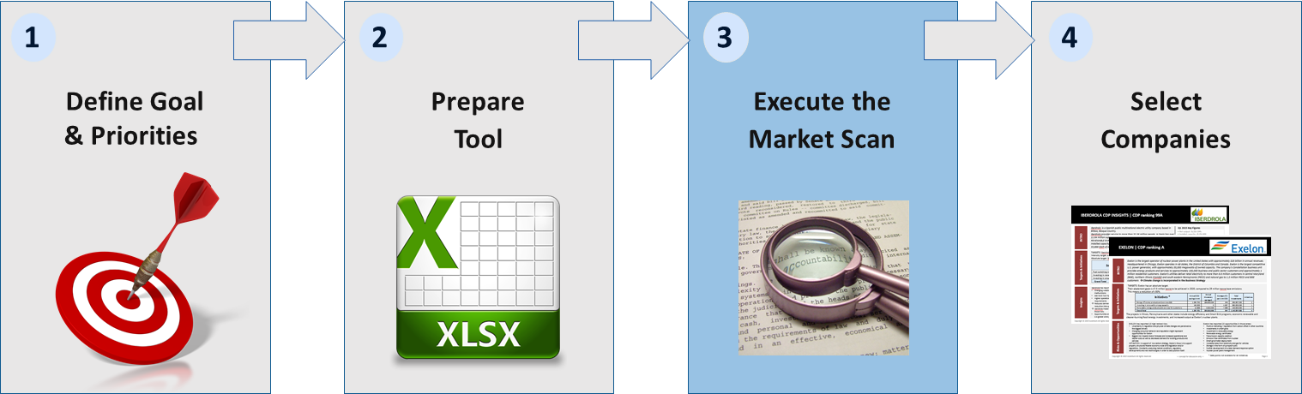
Execute the Market Scan
3
Populate the Market Scan tool
CREATE OVERVIEW OF HELPFUL DATA SOURCES
Create a list of all the different data sources that might be helpful. Example:
Annual reports
Sustainability reports
Industry reports
Associations and their reports
Different sustainability indexes (CDP, Dow Jones)
Existing contacts
Reports from different organization etc.
EXECUTE SEARCH BASED ON PRIORITIES
Populate the Excel market Tool. Start from the sector/industry analysis and see who the main players are.
Companies within
prioritized sectors:
Agriculture
Mining
Beverages
Big companies
within your country
outside of
prioritized
sectors
Other
companies including
the local
companies
vulnerable to
water risks
MARKET SCAN
Complete
Overview
  First focus on the information that is publicly available. Start populating all the different columns, if you get stuck move on to
  the next company and revisit the columns with missing information later. Eventually, approach companies directly →
  Survey/research purpose, NOT ENGAGING and “selling” your institution yet
Notes:
Start researching and complete the Market scan
Research what companies are there within the prioritized sectors
Research other sectors – see which sectors are typically water intensive
Research on other big companies → They might have strong CSR and Sustainability and might be willing to participate on your Partnerships
Look into the local companies – starting from the big players (check country reports and local industry reports, Export and different ratings)
First focus on the information that is publicly available: Start populating all the different columns, if you get stuck move onto the next company and revisit the columns with missing information later
Create overview of helpful data sources
Create a list of all the different data sources that might be helpful – include Annual reports, Sustainability report, Industry reports, different indexes, reports from different organization etc.

Slide 9
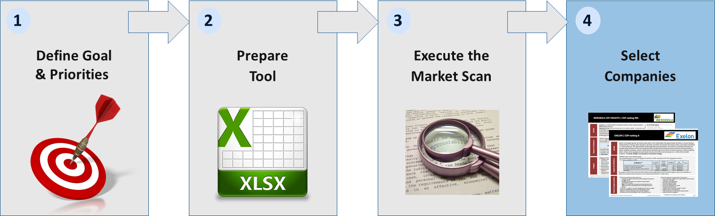
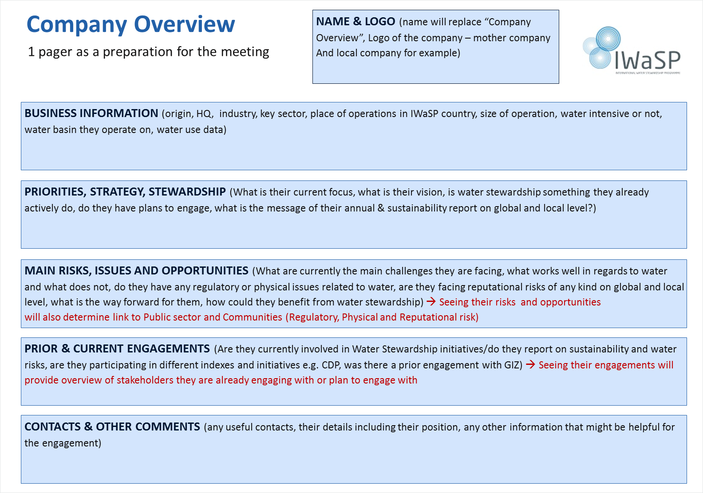
Select Companies
4
Recommend 10 companies for engagement and prepare 1 pagers
TOP 10 COMPANIES SELECTION
After the Market Scan has been finalized, consultant will select 10 most suitable companies for further engagement.
  CRITERIA
High water use & water related risks
At least medium Sustainability Involvement
Water Stewardship/operations improvement a part of their strategy
Water basin shared with more stakeholders
Indication of potential interest in Water Stewardship
Clear business case
Known & New potential companies should be considered
AGREE SELECTED COMPANIES
Consultant will report and discuss those selected companies with you. Once agreed, consultant will then prepare more detailed overviews → 1 pagers
1 PAGER
1 pagers will be use as a preparation for the meeting with the company. It includes overview of business, strategy highlights, risks and issues, engagements and list of potentially relevant people.
The project coordinator will meanwhile create an overview with all relevant events for potential engagement of private sector. And set up initial meetings with the top 10 selected ones.
Notes:
Top 10
After the Market Scan has been done, consultants will select 10 companies that have high water use, risks, water stewardship in Strategy/Sustainability report and discuss those with you. He/She will then prepare more detailed overviews
(1 pager) to help the coordinator prepare for the meeting.
Based on the data gathered and available decide which companies you want to approach as first:
Which companies are clear on their Water risks or for what companies there are clear water risks?
Which companies already have Water Stewardship awareness?
What are the basins where more big companies with water risks are?
What are the companies where you have already some good connections or where you know someone who knows decision makers at this company?
What are the new companies where you need to make the engagement from the scratch but where the partnership might be very suitable and successful?

Slide 10
1 Pager
NAME & LOGO (name will replace
“1 Pager”, Logo of the company – mother
company & local company for example)
Company overview as a preparation for the meeting
BUSINESS INFORMATION (origin, head quarter industry, key sector, place of operations in study country, size of operation,
water intensive or not, water basin they operate on, water use data)
PRIORITIES, STRATEGY, STEWARDSHIP (What is their current focus, what is their vision, is water stewardship something they already
actively do, do they have plans to engage, what is the message of their annual & sustainability report on global and local level?)
MAIN RISKS, ISSUES AND OPPORTUNITIES (What are currently the main challenges they are facing, what works well in regards to water
and what does not, do they have any regulatory or physical issues related to water, are they facing reputational risks of any kind on global and local
level, what is the way forward for them, how could they benefit from water stewardship) → Seeing their risks and opportunities
will also determine link to Public sector and Communities (Regulatory, Physical and Reputational risk)
PRIOR & CURRENT ENGAGEMENTS (Are they currently involved in Water Stewardship initiatives/do they report on sustainability and water
risks, are they participating in different indexes and initiatives e.g. CDP or GIZ) → Seeing their engagements will
provide overview of stakeholders they are already engaging with or plan to engage with
CONTACTS & OTHER COMMENTS (any useful contacts, their details including their position, any other information that might be helpful for
the engagement)

Slide 11
Benefits for Public Sector
The market scan indented to map the Private Sector could benefit also Public Sector (selected authorities)
BENEFITS FOR PUBLIC SECTOR
Other potential purpose of the Market Scan:
  Information on private sector water users and potential risks can inform policies, strategies and actions
  An advocacy tool with which to initiate dialogue with private sector companies
  An advocacy tool to raise awareness of the importance of water resources management with peer ministries and government leadership
HOW TO INVOLVE PUBLIC SECTOR
Include their needs and priorities from the start
  Consider developing separate outputs tailored for the public sector. How can these be used most effectively (e.g. advocacy event with private sector) – discuss this in advance with them and agree on a plan
  Assess the costs of these extra requirements – do we have the budget and is it worth it? Are there other funding sources that can support?
  Solicit public sector support for data collection – what sources do they have that could be useful? Abstraction licences? Tax information? Companies register?
OUTPUTS
Based on GPS coordinates views/maps per watershed could be created and shared with the Public Sector
One pagers can be created per watershed to support the geographical overviews
Overviews per industry can be created to identify the biggest players on the market
If successful, this will help inspire public sector partners to engage in multi-stakeholder partnerships and give your initiatives more local relevance

