Slide 1
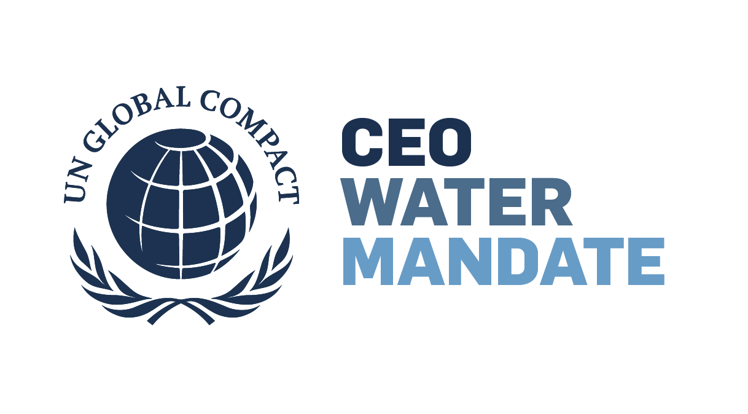
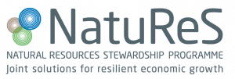
Water Stewardship 101:
Why & how businesses manage risks and advance resilience
Notes:
This presentation outlines why water stewardship helps strengthen your business over the short and long term and how to get started.
We will also touch how the COVID-19 pandemic and water and hygiene-related risks
This presentation was developed by the Pacific Institute, a research organization that creates and advances solutions to the world's most pressing water challenges.
The Pacific Institute is co-secretariat of the UN Global Compact’s CEO Water Mandate
The Mandate connects your business to a global network of stewardship practitioners and provides resources to understand water risks and make a plan for action

Slide 2
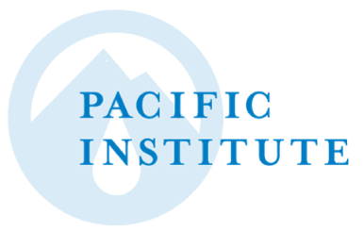
Overview
The global water crisis
Why water stewardship?
The water stewardship journey
4. Tools and initiatives from the CEO Water Mandate
Notes:
Overview of this presentation
The facts of the global water crisis
Why water stewardship is good for business
How companies set and achieve water goals
And some tools from the CEO Water Mandate and others that can help companies get started.

Slide 3
1. The world water crisis
Water scarcity, pollution, climate change, and more
Notes:
To start off, let’s talk about the world water crisis, including issues of water scarcity, pollution, and climate change

Slide 4
Water use is increasing.
Aral Sea 1989
2014
Notes:
This image shows the Aral (air-ul) Sea in Central Asia, which has seen increased water withdrawals for irrigation over the last 60 years, destroying the local fishery and community water supply
Humans withdraw about four thousand cubic kilometers of water globally every year, which is triple what we withdrew 50 years ago, and withdrawals continue to increase
Global demand for water is predicted to increase by 55 percent between 2000 and 2050
We face a growing challenge to meet all of humanity’s water needs.
Image https://en.wikipedia.org/wiki/Aral_Sea#/media/File:AralSea1989_2014.jpg
Info https://earthobservatory.nasa.gov/world-of-change/AralSea

Slide 5
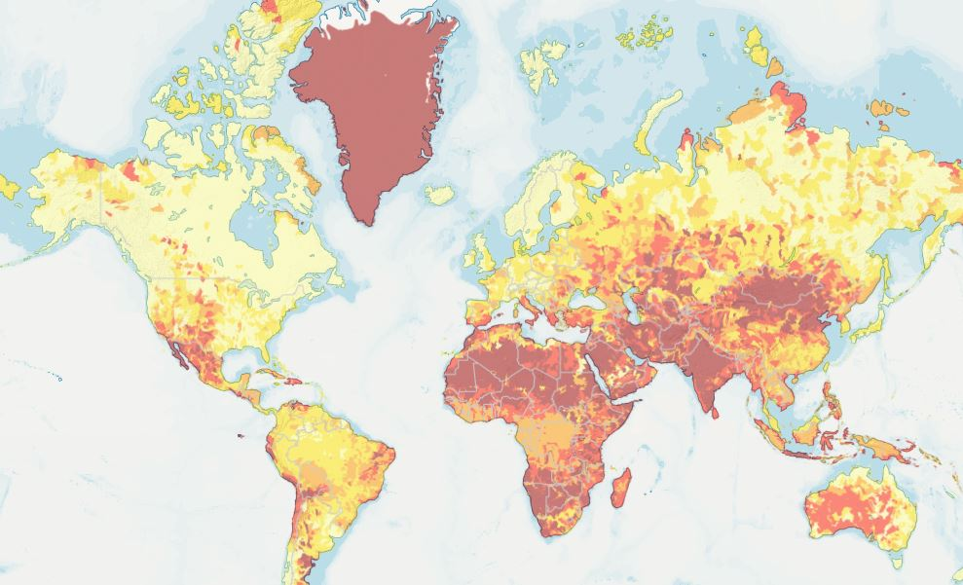
1.7 billion people worldwide live in water-stressed areas.
Notes:
Today 1.7 billion people live in river basins where water demand outstrips supply, known as water-stressed areas.
By 2050, that number is expected to jump to 5 billion.
Source: UN Water https://www.unwater.org/water-facts/scarcity/
MIT https://news.mit.edu/2014/predicting-the-future-of-global-water-stress

Slide 6
80% of wastewater is discharged without treatment.
Notes:
Even if there is adequate water in an area, the basin can still experience water stress due to pollution
Nearly all human uses of water, from agricultural to industrial to municipal, result in water pollution.
2 million tons of sewage and industrial and agricultural waste are discharged into the world’s water every day (UN WWAP 2003)
Currently, over 80 percent of the world’s wastewater is discharged back into rivers, streams, and oceans without any treatment, causing widespread damage to ecosystems and contamination of critical human water sources.

Slide 7
Billions of people lack access to drinking water, sanitation, and hygiene (WASH).
40% of households lack soap and water
50% of schools lack soap and water for students
40% of healthcare facilities lack soap and water or hand sanitizer at points of care (WHO/UNICEF)
Notes:
Access to clean water is always crucial for the health of individuals and families. But in the era of COVID-19, access to handwashing is crucial to stop the spread of the pandemic.
Worldwide, 2.5 billion people lack access to improved sanitation, more than one third the world’s population
As of 2017, 2.2 billion people lack access to safe drinking water (source: WHO)
Over 800,000 children younger than 5 years of age perish from diarrhea each year, often caused by inadequate WASH access, according to UNICEF
Although COVID is not a water-borne disease, handwashing is necessary to combat the spread of the pandemic.
https://www.cdc.gov/healthywater/global/wash_statistics.html#four
https://stats.unctad.org/Dgff2016/planet/goal6/index.html

Slide 8
Notes:
This is the World Economic Forum top 5 global risks published each year
Water crisis has been in the top global risks for the past seven years

Slide 9
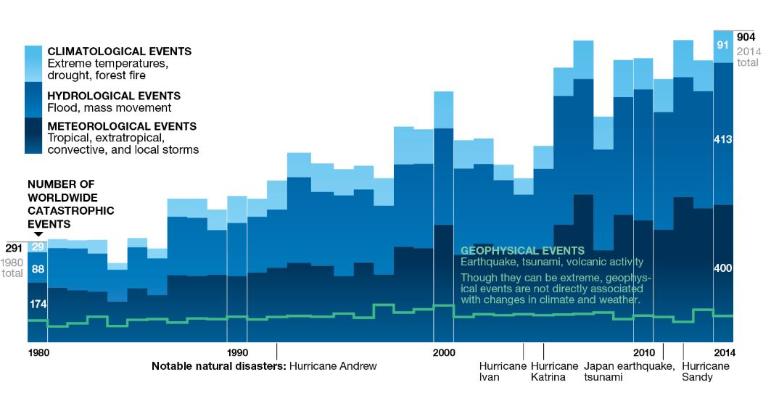
Source: National Geographic
Notes:
Climate change is already creating water crises. In fact, the effects of climate change are felt as water crises – if climate change is the shark, water is the teeth.
Already seeing increased intensity of water-related natural events like droughts and floods, and this trend is expected to continue
This National Geographic chart shows the dramatic increase of worldwide catastrophic events linked to climate
The climate crisis affects the water cycle:
As temperatures rise, snow melting earlier and faster, causing flooding, while in summer water supplies are diminished causing droughts
Number of people at risk from floods is projected to hit 1.6 billion in 2050, with $45 trillion worth of assets at risk.
On the other extreme, as discussed, drought will intensify the already increasing global water demand
Globally, climate change effects will cause US$4.2trn of damage to assets – at a minimum – up to three times that much in extreme scenarios
https://www.climate.gov/news-features/featured-images/2017-state-climate-global-drought

Slide 10
2. Why water stewardship?
Understand and address water risk, reduce costs, and more
Notes:
Water stewardship is good for the planet and good for people, but this section is about the business case
Not as a charity or philanthropic opportunity that creates good will

Slide 11
Addressing water risk benefits business.
Water stewardship is a set of practices to sustainably and equitably manage freshwater resources
Good for the planet, good for people, and good for business
Notes:
Let’s start with some definitions
Now, I want to talk about water risks

Slide 12
Notes:
Companies conduct water stewardship to understand the water related risks to their business
Water risk falls into two general categories
Caused by company’s actions: because they are polluting or wasteful and stakeholders have concerns
But also due to context that a company can’t control. A company could be incredibly efficient and responsible, but if it’s acting in a place where shared water resources are poorly managed, it still faces risk
Water stewardship is not just about being a good actor, but about ensuring that river basins in which you operate are sustainably managed

Slide 13
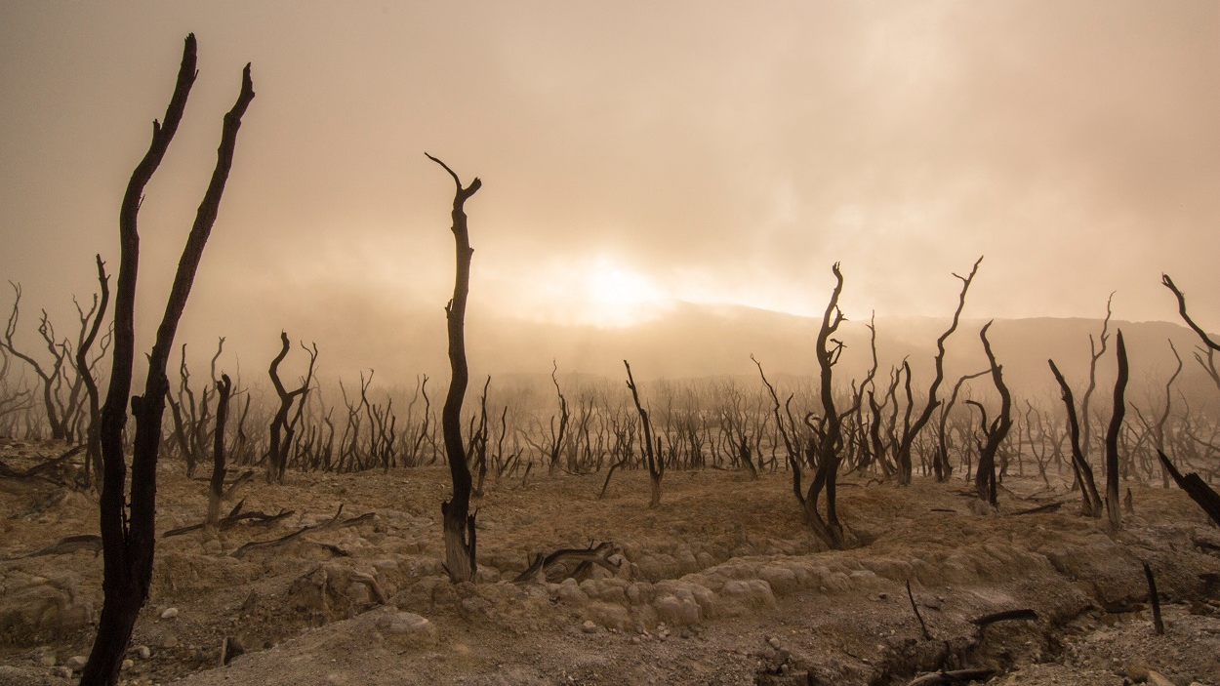
Operational and supplier disruptions cause major losses.
In 2018, companies reporting to CDP reported $38 billion in water-related losses.
2.1 billion people worldwide lack access to safe drinking water
Notes:
One way water challenges affect business is through disrupting the operations of the company or their suppliers
Many leading industries require water as a production process input or product ingredient
Vulnerable to water shortages, drought, even if abundant water but it’s polluted
Even if a company’s own facilities are not experiencing water stress, if its suppliers are, the company may still be unable to procure the goods to produce its own goods
For example, Brazil recently faced a drought that caused both water and electricity costs to rise, which cost General Motors by US$2.1 million extra for water and $5.9 million for electricity

Slide 14
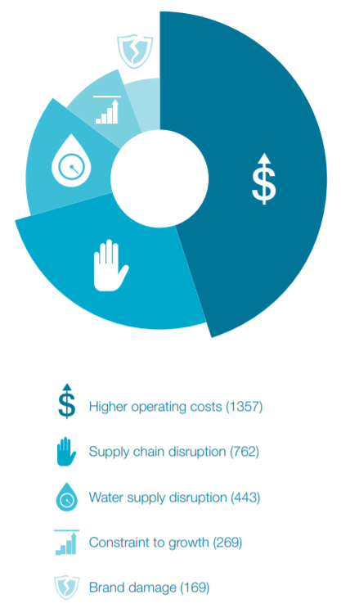
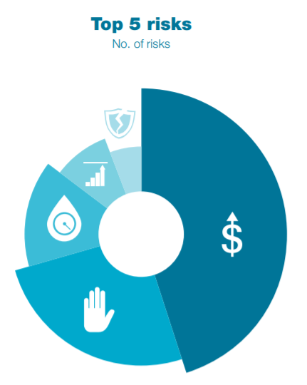
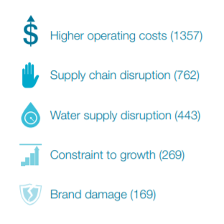
Loss of license to operate can lead to brand damage, consistently reported as a top water risk.
CDP 2017
Notes:
Even if there is physically enough water for companies to continue production in a basin and prices remain stable, companies can also still lose their license to operate if they are perceived as unfairly contributing to a river basin’s water-related challenges through pollution or excessive water use
can lose their legal license to operate if regulators sanction business
can lose their social license to operate if concerns from local communities disrupt business
Example: Coca Cola was forced to close its plant in Plachimada, Kerala due to perceptions that the company used too much of the community’s groundwater
Consumers are growing more and more deliberate about the social impacts of their purchases by “voting with their dollars”
Companies reporting to CDP in 2017 identified brand damage as one of their top five risks related to water.

Slide 15
WASH is essential to public health.
Notes:
It’s vital to give workers access to handwashing facilities at work
Lack of access to to drinking water, sanitation, and hygiene (WASH) services – now more than ever -- harm workers and greatly diminishes productivity for companies
As one example, Levi Strauss invested in health education and on-site health services. Absenteeism fell by 55% and staff turnover dropped from 50% to 12%. One factory calculated a $4:$1 return on investment (ROI).
https://ceowatermandate.org/files/4-Business-case-WASH-10-PRINT.pdf

Slide 16
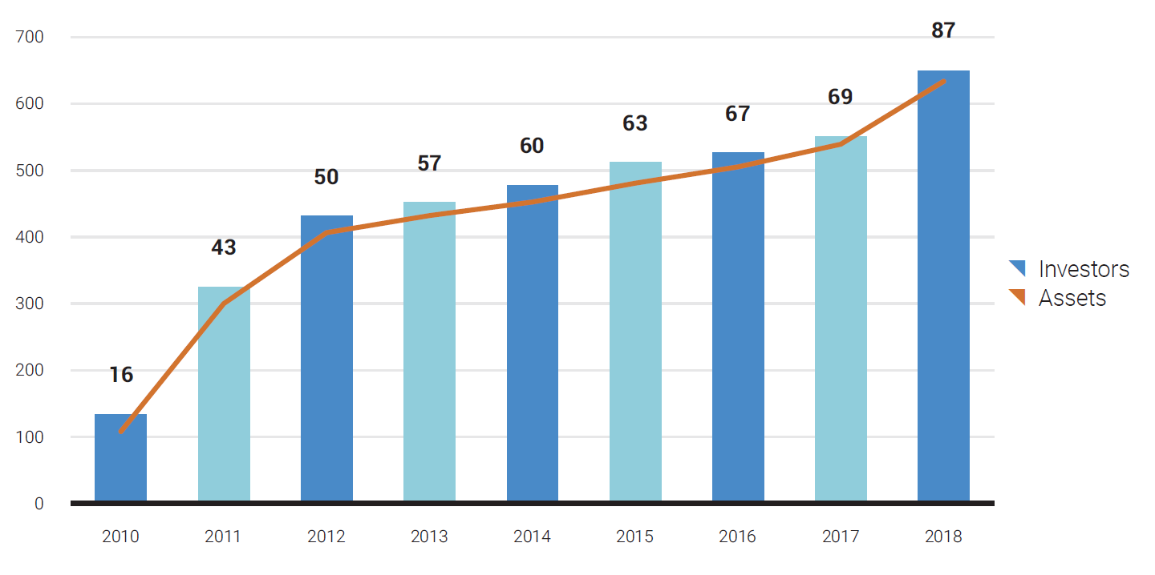
Investors seek to invest in risk-savvy companies.
CDP investors and assets in USD (trillions)
Notes:
If you want proof that there’s a business case for water stewardship, look no further than the investment community
Increasingly demanding that companies demonstrate awareness of water risk
For example, through CDP, 650 investors with US$87 trillion in assets urge companies to both report their water-related risks and impacts, and to take action to mitigate them

Slide 17
Water use efficiency saves money.
Payback period is often less than 1 year
Diageo saved US$3.2 million in 2014
Cisco saves US$1 million every year
Notes:
In addition to managing short and long term risk, water stewardship can directly save money
For companies new to water stewardship, the payback period for initial water efficiency investments can be less than 1 year
Diageo: reduced the volume of its water withdrawals by nearly 1 million cubic meters
Cisco: introduced new soldering practice that reduced water use and wastewater

Slide 18
Seize new business opportunities.
BASF estimates potential sales of US$1 billion from products related to:
Water use efficiency
Recycling
Reuse
Drinking water treatment
Notes:
opportunity to create products
As we wrap up the water risk section, I want to emphasize, if you take one thing away from this presentation, it’s that the world water crisis creates real risk for businesses
Again, not a philanthropy or charity action to create goodwill
It’s about ensuring your business can continue operating and save costs in the process

Slide 19
3. The water stewardship journey
Where to begin?
Notes:
Now that I have introduced why water stewardship is a crucial step for businesses, I want to discuss how businesses can begin to take action on water

Slide 20
Notes:
Every business is going to have its own unique water stewardship journey depending on the industry sector, suppliers, locations
With that said, the CEO Water Mandate has developed this framework called the Water Stewardship Journey to show the major parts of a really strong water stewardship strategy
To unpack this diagram, it illustrates the ideal range of water stewardship activities
Starting at the left, actions around operations typically are a good starting place, as you move to the right, actions become more involved but more impactful

Slide 21
Operations
Provide drinking water, sanitation, and hygiene (WASH) access to all workers
Measure and monitor water performance
Improve water use efficiency and reduce pollution
Notes:
Ensuring company’s own house is in order, from corporate offices, ag site, or manufacturing sites
Establishes your company’s credibility when you engage with stakeholders, fellow businesses, and NGOs on water issues

Slide 22
Context
Understand water-stressed and high-risk basins
Assess risks and impacts along the value chain
Notes:
One important aspect of water challenges is that they are inherently local
Climate is different. emissions reduction will have the same benefit regardless of where a company reduces emissions, so for companies the goal is to reduce their global emissions.
For water the impacts and risks vary substantially by location. If you reduce water use only where water is abundant, it will have minimal impact.
For water, really considering the location allows you to have the greatest impact.
Risk assessment means understanding which of their operations are experiencing the most water stress and where to prioritize actions
The goal is to prioritize where and how to act

Slide 23
Strategy
Develop a comprehensive water stewardship plan for your company
Notes:
- Integrating water stewardship into the business plan is about developing a comprehensive water stewardship strategy that is part of business, not as charity but as protecting business

Slide 24
Engagement
Advance water security through collective action
Facilitate improved performance in the value chain
Notes:
As I discussed, much of the risk companies face is not due to their own operations but to the context in which they’re operating. Engagement is about going beyond the fence line to work with other businesses, value chain partners, NGOs, and stakeholders to ensure water security in a watershed
This is where the good work you have done within your fenceline will help establish credibility

Slide 25
Communication
Achieve meaningful and inclusive dialogue with stakeholders
Notes:
It’s crucial that throughout this process, a company’s understanding of its risks and approaches is done in dialogue with the stakeholders most affected.
Ongoing process of communicating with and reporting to stakeholders

Slide 26
4. The CEO Water Mandate
Supporting your water goals

Slide 27
What is the CEO Water Mandate?
UN Global Compact water stewardship commitment platform for both “leaders and learners”
Commit to action, access resources, and collaborate with partners
Deeper engagement via the Action Platform and the Water Resilience Coalition
Notes:
Endorsers commit to report annually and improve across the six commitment areas

Slide 28
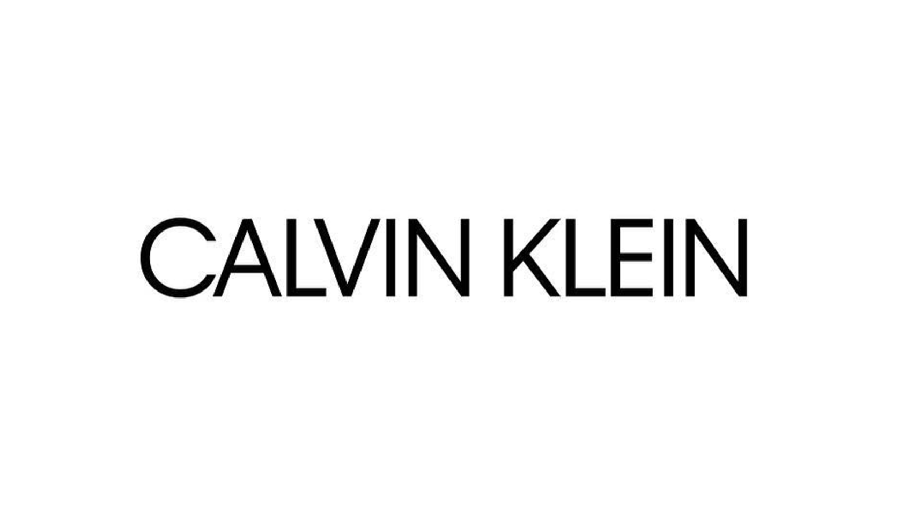
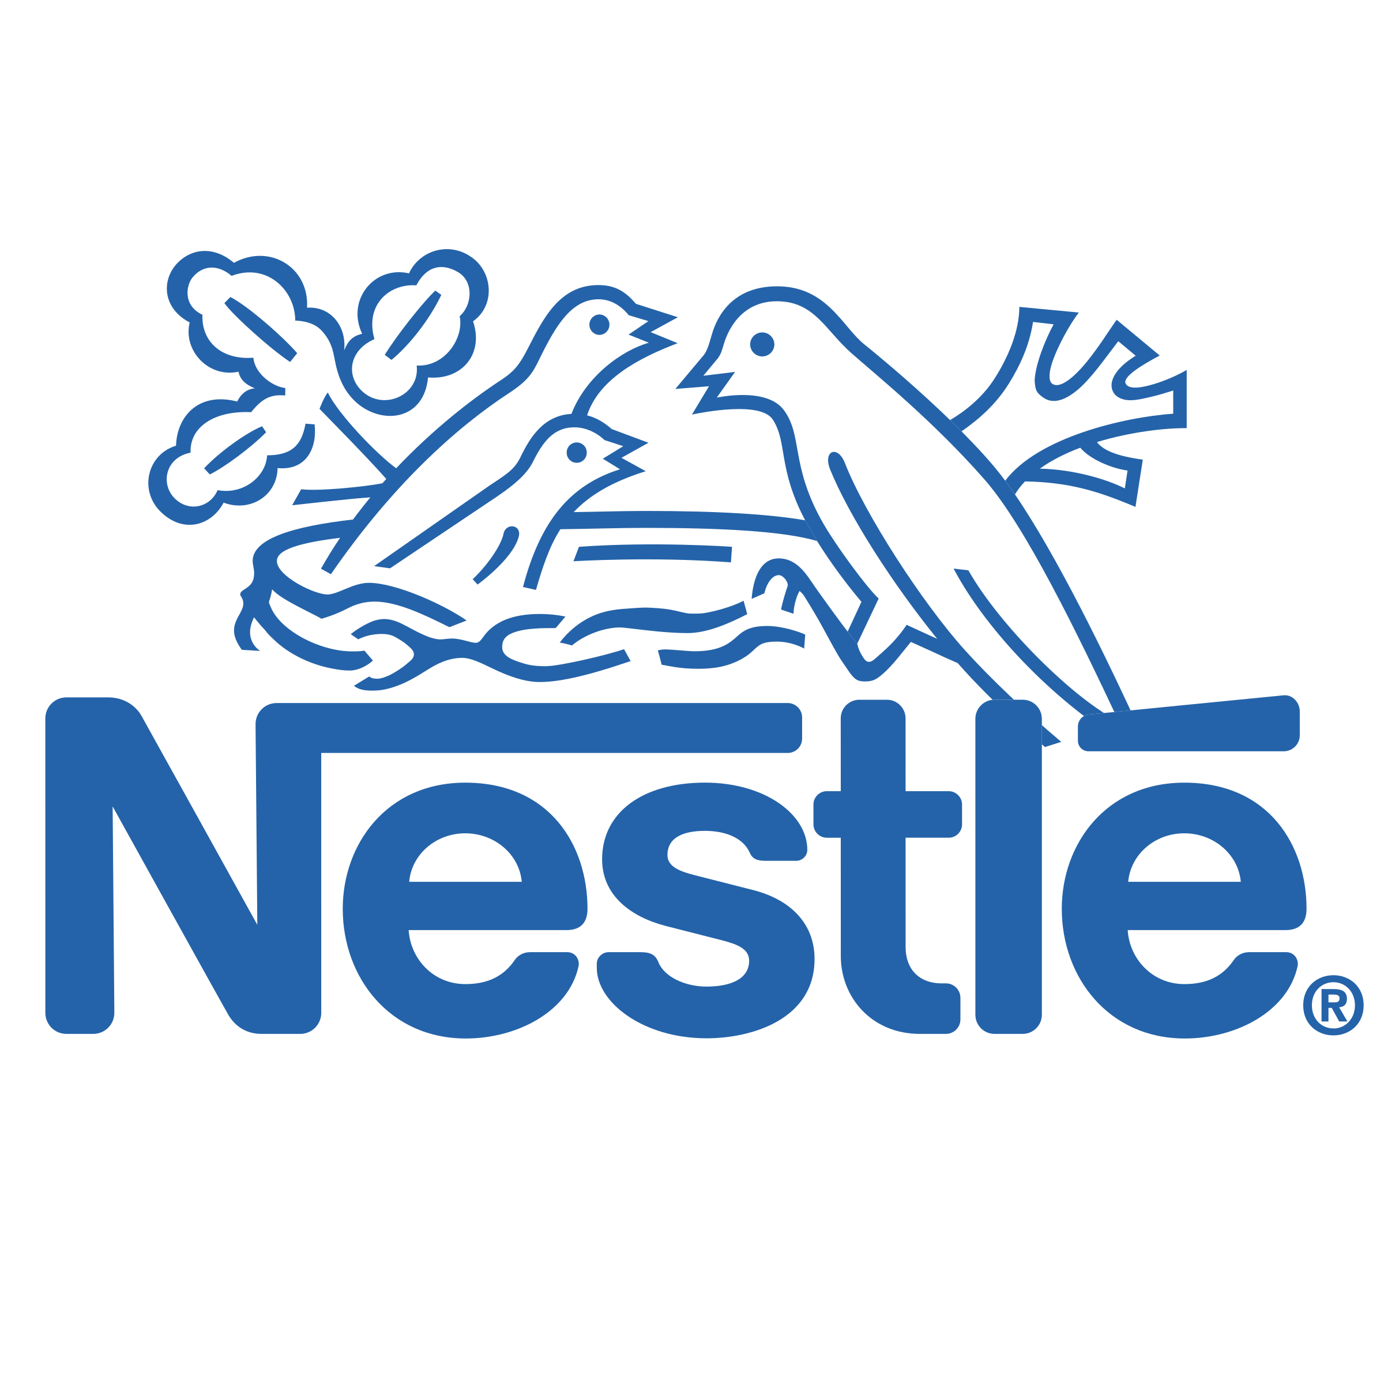
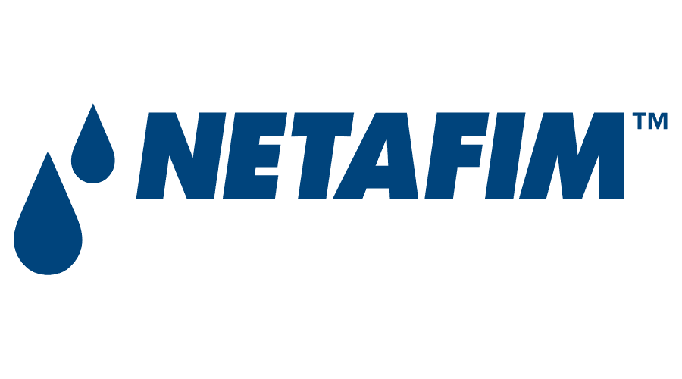
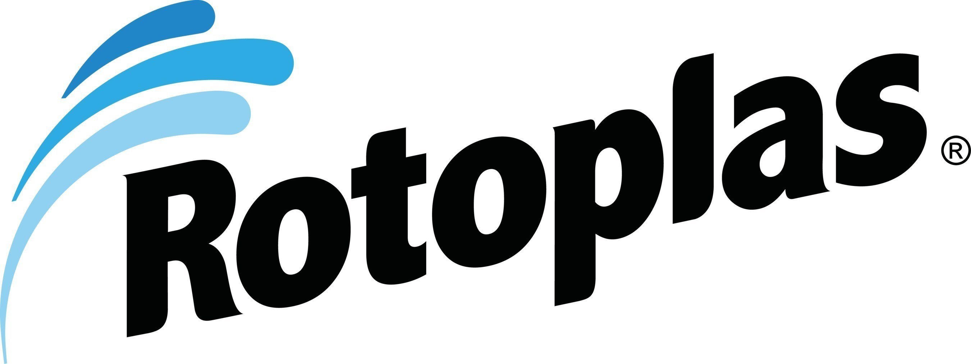
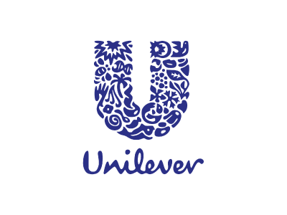
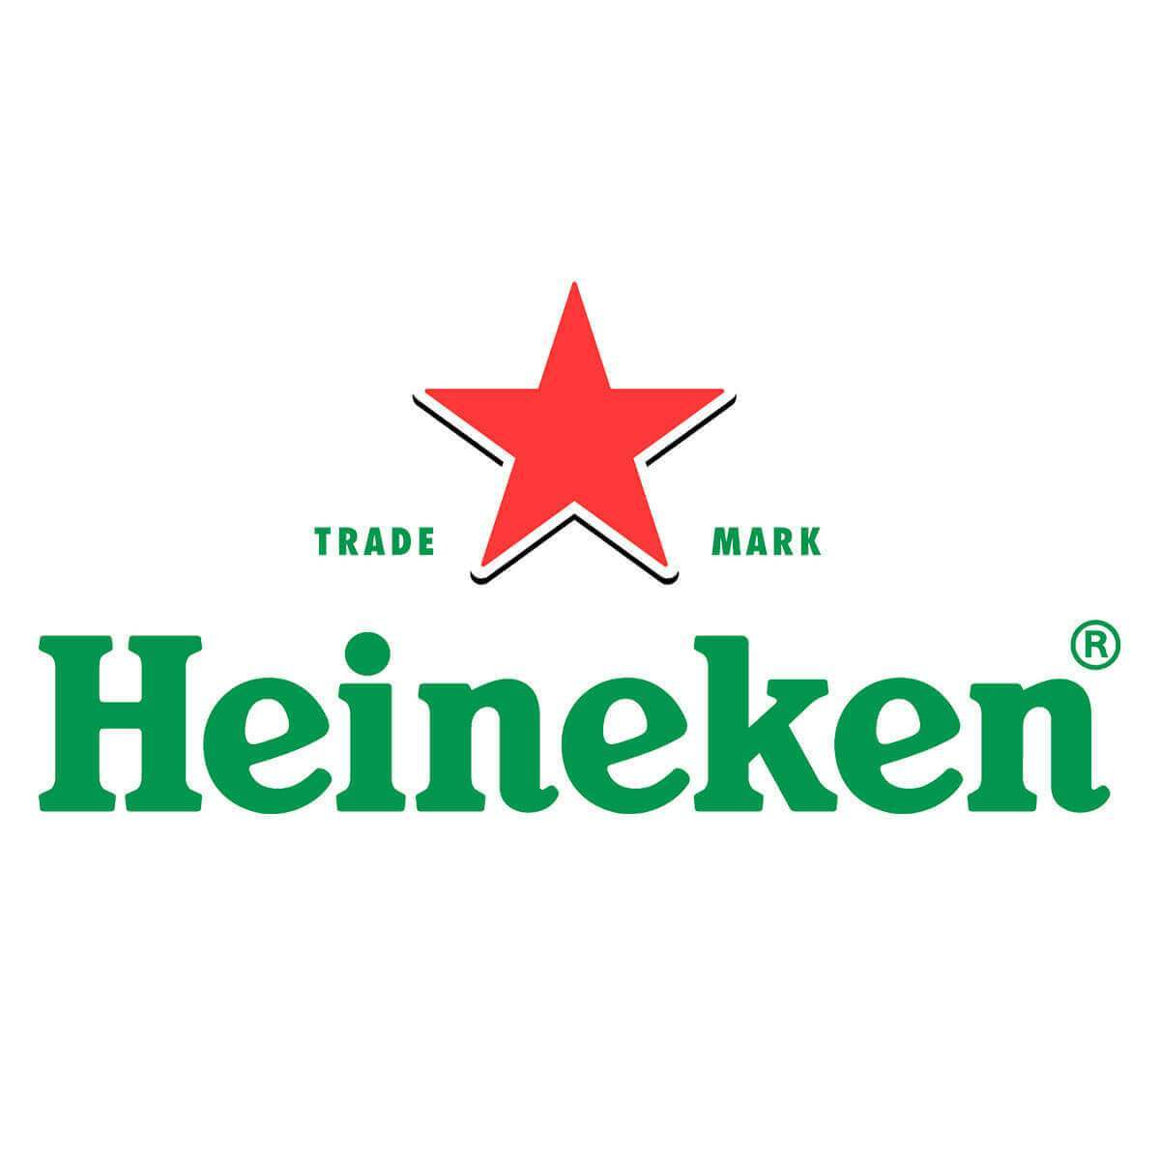
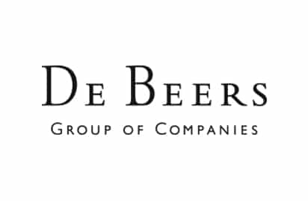
175+ businesses have endorsed the Mandate.
Notes:
This slide shows logos from a few Mandate endorsers -- so you are in good company

Slide 29
The Mandate’s 6 commitment areas
Direct Operations
Supply Chain & Watershed Management
Collective Action
Public Policy
Community Engagement
Transparency
Notes:
Endorsers commit to improve across the six commitment areas
Every year, endorsers report on their efforts to the Mandate and stakeholders

Slide 30
The Mandate’s Water Resilience Coalition
Industry-driven, CEO-led coalition
Goal: elevate global water stress to the top of the corporate agenda
Ambitious, quantifiable 2050 goals
Notes:
Separate from Action Platform
New initiative launched this World Water Day, CEO-led coalition to preserve the world’s freshwater resources in the face of climate change through collective action in water-stressed basins by setting concrete, measurable targets to achieve by 2050

Slide 31
The Mandate hosts and develops resources.
Water Stewardship Toolbox
Water Stewardship University
Water Action Hub
Biweekly Mandate newsletter
Notes:
The Mandate develops and hosts many resources and publications. This is just a selection
In addition, the Mandate holds webinars, events, and conferences

Slide 32
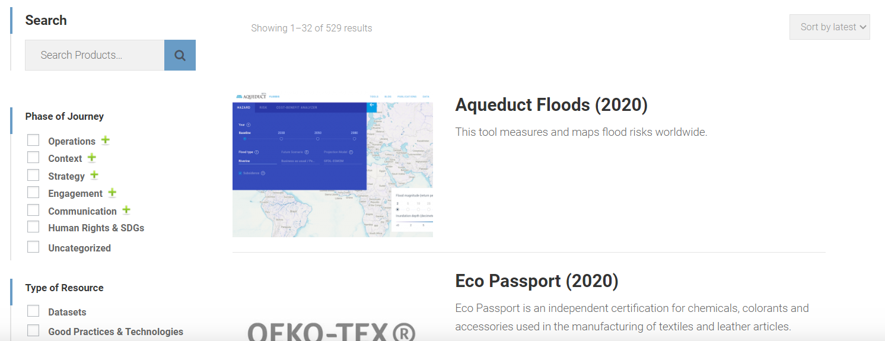
Water Stewardship Toolbox
ceowatermandate.org/toolbox
Notes:
The Water Stewardship Toolbox offers filters to locate the most relevant resources
As well as suggested collections of resources by topic

Slide 33
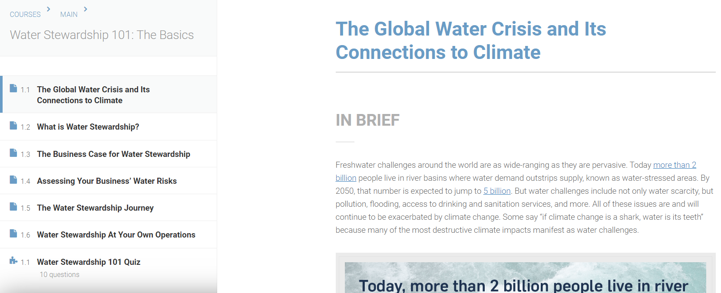
Water Stewardship University
ceowatermandate.org/university
Notes:
The Water Stewardship University offers free classes to introduce stewardship topics
The first course, Water Stewardship 101: The Basics, gives a brief intro to the most important water risks for businesses

Slide 34
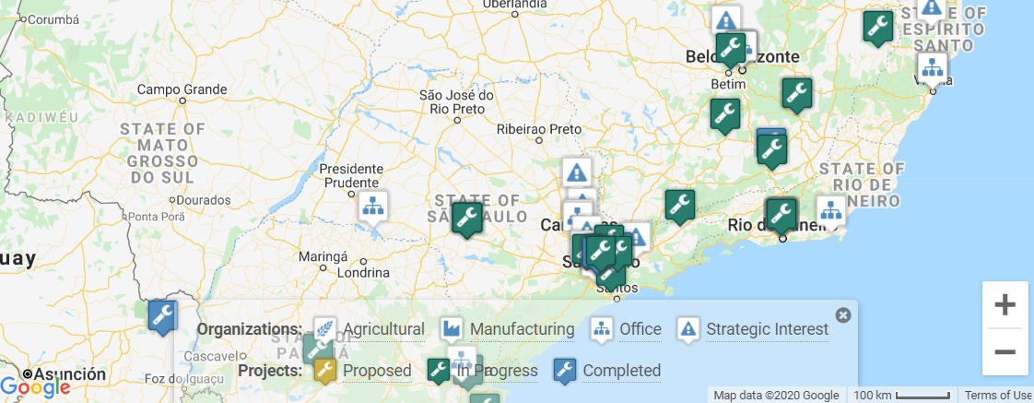
Water Action Hub: Connect to new partners.
wateractionhub.org
Notes:
The Water Action Hub is a free global online platform for collaboration and knowledge-sharing
Connect with other companies, NGOs, technology providers, and more
This image shows one section of the map search with pins for different projects and organizations

Slide 35
Thank you!
NAME
Pacific Institute / CEO Water Mandate
Email
Notes:
In summary, water stewardship can both achieve sustainable water management and strengthen your business
It’s not a charity or philanthropic activity but a way to address short and long term risk
The CEO Water Mandate can help you understand those risks and make a plan for action

