Slide 1
ANNUAL GENERAL MEETING
27/28 OCTOBER 2021

Slide 2





AGENDA
Welcome
5 minutes
Overview of MANdate Priorities in 2021 and Finances
15 minutes
Update on Workstreams and Plans for 2022
35 minutes
Opportunities for Engagement – Governance and how to engage
30 minutes

Slide 3
























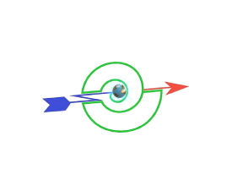







New CEO Water Mandate Endorsers
*
*
*
Soon to announce
Notes:
Most number of endorsing companies since the founding of the Mandate – over 30 companies so far have endorsed this year pushing the endorsing numbers to over 200

Slide 4
CEO Water Mandate 2021-2023 Strategy
2021-2023 Focus: Scaling the adoption of water stewardship practice by companies in critical geographies and industry sectors
1
2
3
Innovation and Leading Edge-Thinking | Scaling Responsible Practice & Drive Basin Resilience | Raise the Profile of Water & Shape the Enabling Environment
Communications and Outreach
Notes:
Climate and Water + a rebalancing of focus from innovation towards scaling, raising the profile and communications

Slide 5
Overview of Work Program – Priorities in 2021
1
2
3
Innovation and Leading-Edge Thinking | Scaling Leading Practice and Drive Basin Resilience | Raise the Profile of Water and Shape Enabling Environment
Advance Concept of Net Positive Water Impact Multiple Benefits of Nature Based Solutions Water Resilience Assessment Framework Science Based Targets Network Thought leadership events at Stockholm World Water Week | Recruitment of new members for both the Mandate and Water Resilience Coalition from key geographies and industry sectors Promote support and implementation of new guidance (peer learning webinars, socializing member tools, WASH4Work implementation) Support for the California Water Action Collaborative Facilitate multi-stakeholder collaborations in basins Water Action Hub development and build out | Establish and activate CEO Circle of the Water Resilience Coalition Engagement in key international events (UNGC Leaders Summit, General Assembly, and COP 26) Engage in industry sector events and provide input into an external standard Work with WRI on public water management database

Slide 6
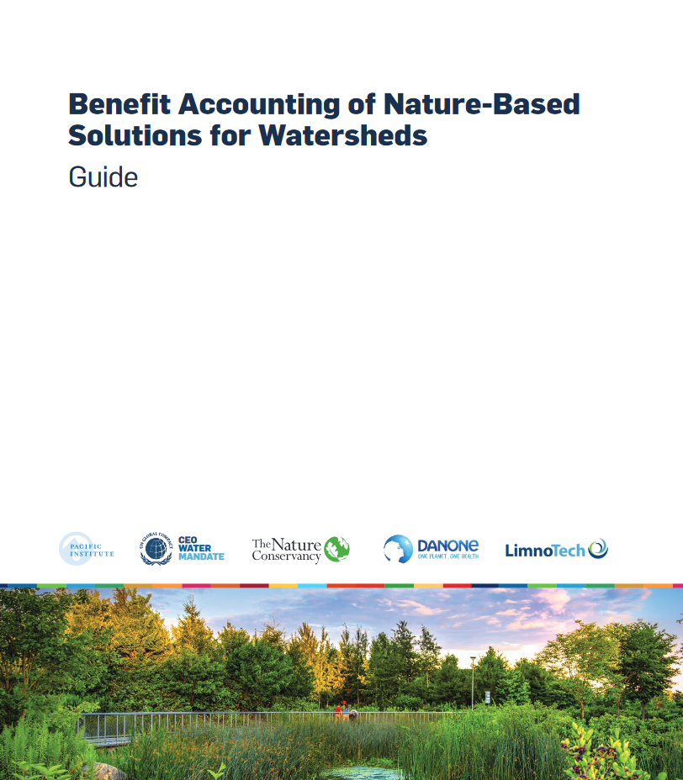
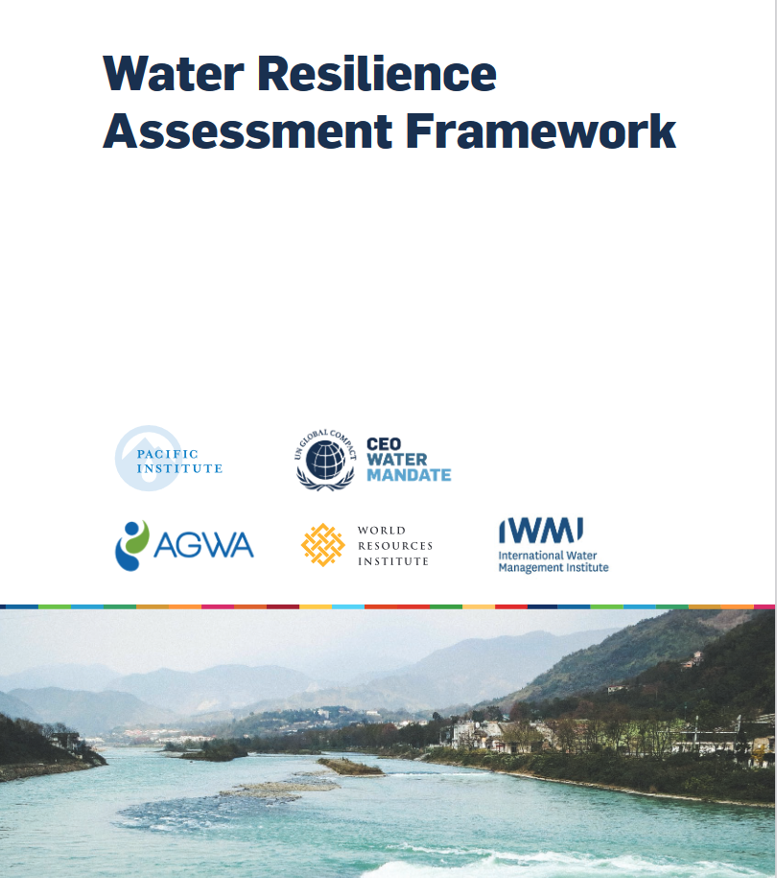

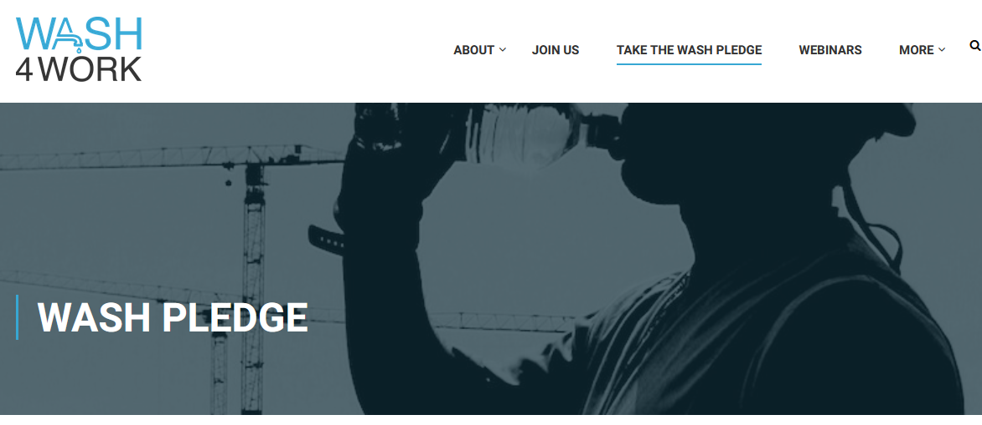

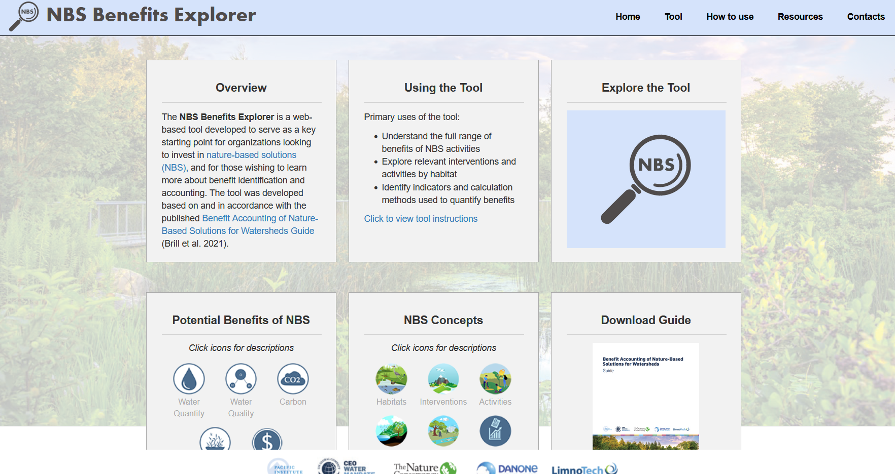
Snapshot of Achievements in 2021
Innovation and Leading-Edge Thinking
Scaling and Driving Basin Resilience
Raising the Profile
Water Resilience Coalition 2030 Ambitions: 100 basins, 3 billion people, 100 million WASH
Water Resilience Coalition 11 multi-stakeholder collaborations
)

Slide 7
Progress
Strategic priorities | Workstreams & targets by Year End 2021 |  | Progress
Innovation and Leading-Edge Thinking | Peer Learning opportunities | 15 companies sharing knowledge and leading practice
 | Innovative initiatives and programs delivered | 2 initiatives
Scale Responsible Practice and Drive Basin Resilience | Growth in membership and level of member engagement | 50 new endorsing companies and improved level of engagement
 | Uptake and implementation of new/existing products | 12 companies set/commit to setting contextual water targets
 | Implementation of collaboration | 2 collaborations
Raise the Profile of Water and Shape the Enabling Environment | Active representation of business voice for water | 1 external standard or policy influenced
 | Engagement in public policy | 2 international, regional, or national water related public policy forum presented at
1
2
3
ON-TRACK
(≥95% of target)
Partially Met
(≥70% of target)
OFF-TRACK
(≤70% of target)
Notes:
15 companies in the past year COP analysis included contextual water targets

Slide 8
Overview of Finances
ACTIVITIES | 2021 ESTIMATED EXPENSE (USD$)
Mandate Secretariat Support Functions
Strategic Planning and Partnerships | $ 230,000
Technology and Communications
Project and Working Group Facilitation
Governance and Accountability
Strategic Pillars
Innovation and Leading-Edge Thinking | $ 521,435
Scaling Responsible Practice and Basin Resilience | $ 1,254,500
Raise the Profile of Water and Enabling Environment | $ 235,670
TOTAL | $ 2,232,605
* Includes events and travel related to furthering work
OVERVIEW OF MANDATE FUNDING SOURCES
Contributions from Companies | $ 1,950,000
External Support from Partners for WASH4Work | $ 4500
SIDA | $ 245,435
Ramsar | $ 24,000
Science Based Targets Network | $ 42,000
WRI – Public Water Management Database | $ 25,670
TOTAL | $ 2,291,605

Slide 9
Questions?

Slide 10
Looking Ahead – 2022

Slide 11
“High expectations of business to address and solve today’s challenges has never been more apparent.”
Edelman Trust Barometer 2021
DRIVE IMPACT ON SPECIFIC GOALS
7 CHALLENGES WHERE BUSINESS CAN DRIVE MEASURABLE IMPACT
CHALLENGE
IMPACT GOALS
Climate Change
We are on track for a temperature rise of over 3°C. This would bring mass extinctions & large parts of the planet would be uninhabitable.
Companies that have set 1.5°C aligned and/or net-zero targets approved by the Science Based Targets initiative (SBTi)
Human Rights
92% of the SDG targets are linked to international human rights treaties yet less than 20% of companies are taking steps to sufficiently address their adverse human rights impacts.
Increase in the number of companies with ongoing human rights due diligence processes in place.
Labour and
Decent Work
Almost 1 in 10 children subject to child labor ((160 million, first increase in two decades)
Companies implementing UN Global Compact labour principles within all aspects of business operations to provide and promote decent work for all workers across the their supply chains
Gender Equality
At current rate of progress, it will take 268 years to close the economic gender gap.
Companies with targets and corresponding policies and programmes to increase women’s representation and leadership
Transformational Governance
2021 Edelman Trust Barometer reveals an epidemic of misinformation and widespread mistrust of societal institutions and leaders around the world.
Companies taking action to advance SDG 16 internal and external to their organization at the global and local levels
Anti-Corruption
Corruption, bribery, theft and tax evasion cost approximately $1.26 trillion for developing countries per year.
Companies with implemented anti-corruption compliance programmes
SDG Integration
Social Progress Index estimates we are 62 years behind schedule.
All UN Global Compact companies are making demonstrable contribution to the SDGs.
Notes:
Based on the new UNGC strategy that focused on identifying the areas where the UNGC could make the most impact = interviews with companies, local networks, other stakeholders to hone in on a number of key impact areas and to measure that progress. These map against the 10 principles and a number of other areas – you’ll tsee those as Climate, Gender, governance, and the SDGs.
Sources:
Gender Gap: http://www3.weforum.org/docs/WEF_GGGR_2020.pdf
Oceans: https://www.unep.org/interactive/beat-plastic-pollution/
Child Labor: https://www.ilo.org/ipec/Informationresources/WCMS_653987/lang--en/index.htm
Climate: https://www.unep.org/emissions-gap-report-2020
Social Progress Index: https://socialprogress.blog/2020/09/10/announcing-the-2020-social-progress-index/

Slide 12









ALL COMPANIES WHATEVER SIZE, SECTOR OR GEOGRAPHIC LOCATION CAN CONTRIBUTE. WHEREVER YOU ARE ON YOUR SUSTAINABILITY JOURNEY YOU WILL FIND RELEVANT RESOURCES TO HELP YOU PROGRESS
CONNECT
Connect with industry, experts peers and with the UN at the global and national level
LEARN
Gain the knowledge and skills to make progress and deliver impact.
LEAD
Show bold leadership and inspire others. Leverage your position and advocate for major impact
COMMUNICATE
Build trust and credibility by communicating measurable progress towards your sustainability goals and targets
Notes:
The strategy also has a focus on opening up the programmatic offering of the UNGC to assist companies of all shapes and sizes.

Slide 13

UN GLOBAL COMPACT OVERVIEW OF PROGRAMME DELIVERY CHANNELS
  Future oriented programme & thematic incubation. Output-oriented projects focused on content development for programmatic engagement and dissemination. Defines UNGC positioning, thought leadership and ambition on specific issues.
Think Labs
UN Global Compact Academy
  Trainings and master classes (premium content) on fundamental and advanced business practices at the global, regional and local levels
Accelerators
  Facilitated programme that activates and supports cohort of companies to make progress on specific goal over a specific time frame at the local levels
Peer Learning Groups
  Facilitated learning communities that provide participants an opportunity to connect, share, and learn from others at the global, regional and local level.
Policy Advocacy
  Policy advocacy activities to connect relevant stakeholders and shape policy positions
Call to Action & Campaigns
  Timebound Call to Action campaigns for companies to support policy positions and ambitious action at the global and local levels
Tools & Resources
  Connecting participants and stakeholders across programmes and ecosystems
Events
14
  Across all delivery mechanisms, relevant resources will be developed or leveraged to equip companies with the tools and knowledge to implement business practices aligned with the Ten Principles and the SDGs within their own company

Slide 14




COALITIONS
MULTI-STAKEHOLDER COALITIONS TO DELIVER ON THE SUSTAINABLE
DEVELOPMENT GOALS
Scaling adoption of water stewardship practice by companies in critical geographies and sectors
A principles-based approach to
sustainable
ocean business
Enabling companies to set science-based emissions reduction targets
Scale SDG-linked
corporate
investment
Notes:
Coalitions where we drive scale in partnership with other organisations
CEO Water Mandate
The Water Resilience Coalition, founded in 2020,
is an industry-driven, CEO-led coalition aims tpreserve the world’s freshwater resources through , quantifiable commitments and collective action in water-stressed basins 150 companies
Enabling companies to adopt leading water stewardship practices that support better outcomes for at least 3 BILLION PEOPLE IN 100 BASINS WORLDWIDE
Oceans stewardship coalition
The Ocean Stewardship Coalition promotes a principles-based approach to sustainable oceans business
Scaling and broadening engagement in emerging markets, and small island developing states (SIDs).
The SBTi is a partnership
between CDP, the United Nations Global Compact, World Resources Institute (WRI) and the World Wide Fund for Nature (WWF).
COP26 targets ( 2000 companies overall, 1000 approved targets and 1000 in the 1.5 campaign by COP)
Enables companies to set science-based emissions reduction targets
Near-term targets aligned with 1.5°C
Net-Zero Standard: First science-based framework to set long term net-zero targets
CFO TaskForce
1000 companies linking 50% of corporate financing to Sustainability goals
$500 Billion

Slide 15
Overview of Work Program – Priorities in 2022
1
Innovation and Leading-Edge Thinking
Benefit Accounting for Nature-Based Solutions in Watersheds - Benefit forecasting and valuation - Continued tool refinement - Stakeholder engagement 2. Water Resilience Assessment Framework - Guidance for corporate, public utilities, and basin authorities - Pilot test the WRAF 3. Support the Science Based Targets Network on SBTN for water | 4. Driving understanding and alignment among water metrics (NPWI, SBTN, contextual water targets) 5. Corporate Water Resilience (through the WRC) - Water-resilience practices for value chains - Collective action impact measurement and allocation 6. Climate Resilient WASH (WASH4Work)

Slide 16
Overview of Work Program – Priorities in 2022
2
Scaling Leading Practice and Drive Basin Resilience
1) Recruitment and help improve implementation of water stewardship New geographies and sectors Business mentoring Create a pathway for engagement 2) Promote and support implementation of new guidance and tools Identify practical tools used by endorsers to help operationalize Hold more member knowledge sharing sessions and blog pieces Facilitate uptake of topical stewardship work (contextual water targets) Expand the scope of Water Action Hub to help companies benchmark their water and climate performance against industry peers | 3) Scaling Responsible Practice through Coalitions Develop mechanisms to assist and track WRC companies in NPWI implementation Implementation of the Water Resilience Coalition’s 2030 Roadmap Support implementation of WASH resilience (through WASH4Work) 4) Scale basin collective Action California Water Action Collaborative (South Coast Working Group) Advance collective action in key basins through the Water Resilience Coalition Collective Action in Mexico, South Africa, India, Brazil, United States (12 multi-stakeholder collaborations) | Strengthen core functionality of the Water Action Hub to facilitate scaling collective-action by streamlining existing tools to better facilitate matchmaking and support decision-making for on-the-ground action 5) Tool Development: Knowledge Sharing Platform and Resource Libraries
Notes:
Bring on additional resources to really support this first pillar – recruitment, support and implementation of guidance.
CA – Lead detection work in Los Angeles
Diageo – Collective Action Work
Danone – NPWI webinar

Slide 17
Overview of Work Program – Priorities in 2022
3
Raise the Profile of Water and Shape Enabling Environment
Dedicate more time for advocacy on water Identification of key high-level international events for advocacy (leading up to UN Water Conference in 2023) Utilize the Water Resilience Coalition for CEO Advocacy Industry events Input from full membership on industry standards Increase external exposure Outreach to strategic media channels and influential opinion leaders Strengthen digital presence Potential campaigns on water | Explore opportunities for public-private sector alignment on water launch of the Water Stewardship Acceleration Forum co-led with GIZ and AWS COP – Water Updates To review current COP-Water guidance and to explore avenues to align with new UNGC COP process

Slide 18
Questions and Discussion

Slide 19
Mandate Governance

Slide 20
Mandate Governance
High-level
Strategic Oversight
Shorter-term
Planning and Implementation
Mandate
Steering Committee
CEO Circle
WRC Leadership
WRC WGs
WRC Members*
Ambitious, time-bound targets
Global advocacy
Collective action
Mandate Advisory Group
Mandate Endorsers
Continuous improvement
Peer learning
Capacity building
Level of commitment
Coordination and Technical Support
CEO Water Mandate Secretariat
* Mandate endorsement is a prerequisite to WRC membership

Slide 21
Mandate Governance Updates
  Steering Committee seats will be allocated to ensure representation from both WRC and non-WRC members
  5 seats will be allocated to WRC members and 5 to non-WRC Mandate members

Slide 22
Member Engagement Opportunities

Slide 23
Strategy Asks all Mandate Endorsers to Engage
Innovation and Leading-Edge Thinking | Scaling Responsible Practice & Drive Basin Resilience | Raise Profile of Water and Shape the Enabling Environment
Provide input into a thought leadership product Commit to pilot-testing | Help develop business case for water Support recruitment of new members Mentoring | Provide input to Mandate review of one external standard or policy in development
Speak at a meeting on thought leadership Write a blog on thought leadership | Share 1-3 tools company uses to operationalize water stewardship Share lessons learned through blog/webinar | Through WRC, utilize CEO or c-suite to elevate importance of water
 | Share resources/projects in online libraries and tools Maintain an active profile on the Water Action Hub Engagement in on-the-ground efforts | Use company voice to advocate for water at appropriate fora

Slide 24

How to Engage
Endorser Wide Meetings
Provides updates and upcoming opportunities
3-4/year
Project Level
Providing input
Piloting projects
Peer Learning
Webinars – nature-based solutions, resilience assessment
Events
Stockholm World Water Week
UN Global Compact events
Others
Blogs
Share company tools/practices
Survey to follow the meeting

Slide 25
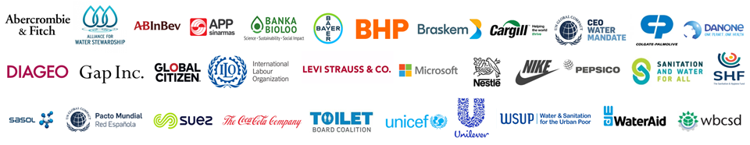
Upcoming Peer Learning Opportunities: WASH4Work Partners Meeting
Agenda
Welcome, Introductions & Meeting Objectives
Lessons Learned from 2020 – 2021
Introduction of the Workplan 2022
Discussion around WASH Resilience
Summary of Discussions & Next Steps
Covering best practices, WASH Resilience, and 2022 agenda of the initiative, WASH4Work's Full Partners Meeting brings together Mandate Endorsers and WASH Pledge Signatories.
The 2-hours event will be hosted in duplicate sessions on the 29th and 30th of November to accommodate global time zones.
29th of Nov (Monday): 3pm – 5pm UK time (Americas, Europe & Africa time zones). Register here.
30th of Nov (Tuesday): 10am – 12pm UK time (India & Asia time zones). Register here.

Slide 26
Steering Committee Nominations
Reconstituted Mandate Steering Committee for 2022 onwards
Please nominate or self-nominate yourselves for 1 or 2 year terms
Selection of members of the Steering Committee will be guided by the following criteria:
Industry/sector diversity vis-à-vis the SC;
Demonstrated strong commitment and engagement in the Mandate;
Perceived ability to bring fresh and new perspectives
Time commitment: Members meet 3-4 times a year for 60-90 minutes calls
Responsible for financial, administrative, and strategic direction of the CEO Water Mandate
Please send your nominations to Mai-Lan (ha@unglobalcompact.org by November 15, 2021

Slide 27
Road to COP 26

Slide 28


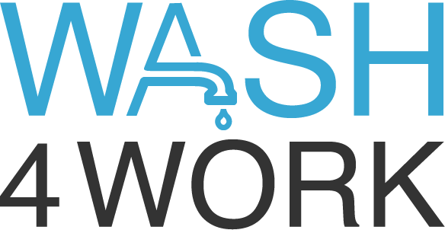
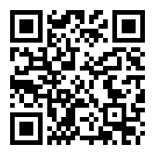

COP26 Upcoming Events
TUESDAY NOV 2
THURSDAY NOV 4
SATURDAY NOV 6
MONDAY NOV 8
  Launch of the Water Stewardship Acceleration Forum (WaSA)
  16:00-17:00 GMT
  A Call to Action: Building Water and Climate Resilience through NBS
  17:30-19:00 GMT
  Partnerships & Finance: Climate Resilient WASH
  13:20-15:20 GMT
  Resilient Together: Water and Climate Adaptation Collective Action from the Private Sector
  13:00-14:00 GMT
Add these events
to your calendar here!
MONDAY NOV 8
WEDNESDAY NOV 10
THURSDAY NOV 11
  Preventing Shocks and Stresses from becoming Crises: The WRAF
  17:30-18:30 GMT
  Resilient Together Retransmission @ UNGC Business Ambition for Climate Action
  16:30 – 17:15 GMT
  WRC CEO Circle Meeting and Press Conference
  15:00 – 16:15 GMT

Slide 29
Road to COP 26
Background:
“Fair Water Footprints” :
  - Zero pollution
  - Sustainable and equitable withdrawal and water use
  - Full access to safe water, sanitation and hygiene for workers
  Working with and protecting nature
  Planning for droughts and floods.
Current support: UK, Switzerland, Netherlands, Finland, Austria, Malawi, African Civil Society Network for Water and Sanitation, CDP, Water Witness, International Institute for Environment and Development, and Chatham House

Slide 30
Road to COP 26
Background:
Commitments encompass general areas made by all
Constituency level commitments (government, business, civil society, partner organizations and other)
Requirements:
Action plan, KPIs, mutual accountability, and yearly meeting to report on progress
Next Steps:
Mandate will circulate document for member input
Please send input back by EOD November 3rd, 2021 (if possible)
Announcement to be made at COP on Nov 5

Slide 31
Questions and Discussion

Slide 32
Financial Model

Slide 33
Financial Contribution
All Mandate endorsers will be expected to make a meaningful contribution
Amount suggested based on revenue (general contribution)
 | Expected Annual Contribution
Company revenue tiers by annual gross sales/revenue
> USD 5 billion | USD 20,000
USD 1 – 5 billion | USD 15,000
USD 500 million – 1 billion | USD 10,000
USD 250 - 500 million | USD 7,500
USD 50 – 250 million | USD 5,000
USD 25 – 50 million | USD 2,500
< USD 25 million | USD 1,250
Discussion if we need to have that contribution earmarked; opportunity for project or event sponsorship
WRC members are encouraged to support non-WRC aspects of the Mandate, but are not required to
Not compulsory

Slide 34
Questions?

Slide 35

Thank you!
  Pacific Institute / CEO Water Mandate
  Email address/ @TwitterHandle

