Slide 1




Bi-Annual
Partners Meeting
2023

Slide 2



Bi-Annual Partners Meeting
2023
AGENDA
Welcome & Opening Remarks
New Leadership Announcements
2022 Achievements & 2023 Outlook
2023 Work Program & Engagement Opportunities
WASH Collective Actions
WASH4Work at the UN Water Conference
Member Benefits & How to Engage

Slide 3
Kate Holme, WaterAid
WASH4Work Chair
2020-2022
Opening Remarks

Slide 4
Michael Alexander, Diageo
WASH4Work Vice-Chair
2020-2022
Opening Remarks

Slide 5


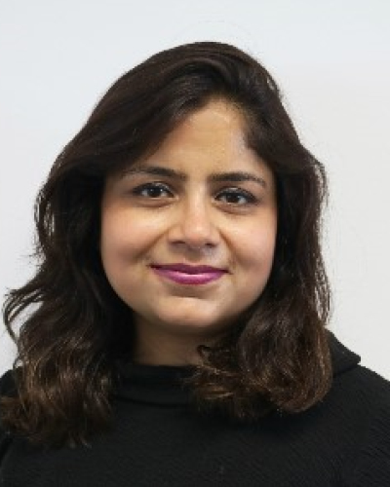

NEW LEADERSHIP
ANNOUNCEMENTS
Co-Chairs 2023-2024
Madhu Rajesh
The Coca-Cola Company
Scott McCready
Alliance for Water Stewardship (AWS)

Slide 6
Cheryl Hicks, CEO Water Mandate
WASH4Work Secretariat
INSIGHTS 2022
& 2023 OUTLOOK

Slide 7

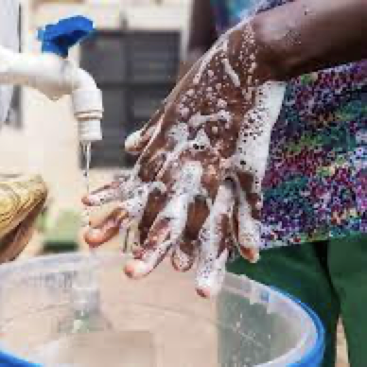


2022
Goals
  Amplifying Business Leadership
  Evolving Best Practice & Standards
  Strengthening the Business Case
  Connecting Members for Scale
  Building Consensus on WASH Resilience
Notes:
In 2022 W4W updated its goals to reflect the changing landscape of water sanitation and hygiene access in the workplace together with WASH expert stakeholders

Slide 8
2022
Achievements
  Standardized WASH Benefits Accounting Method in development
  Consensus & Business Declaration on Climate Resilient WASH
  Consultation on evolving leading practice on WASH in the Supply Chain
  Supplier Working Group Pilot
  New Members & Increased Member Engagement
Notes:
Significant progress was made

Slide 9
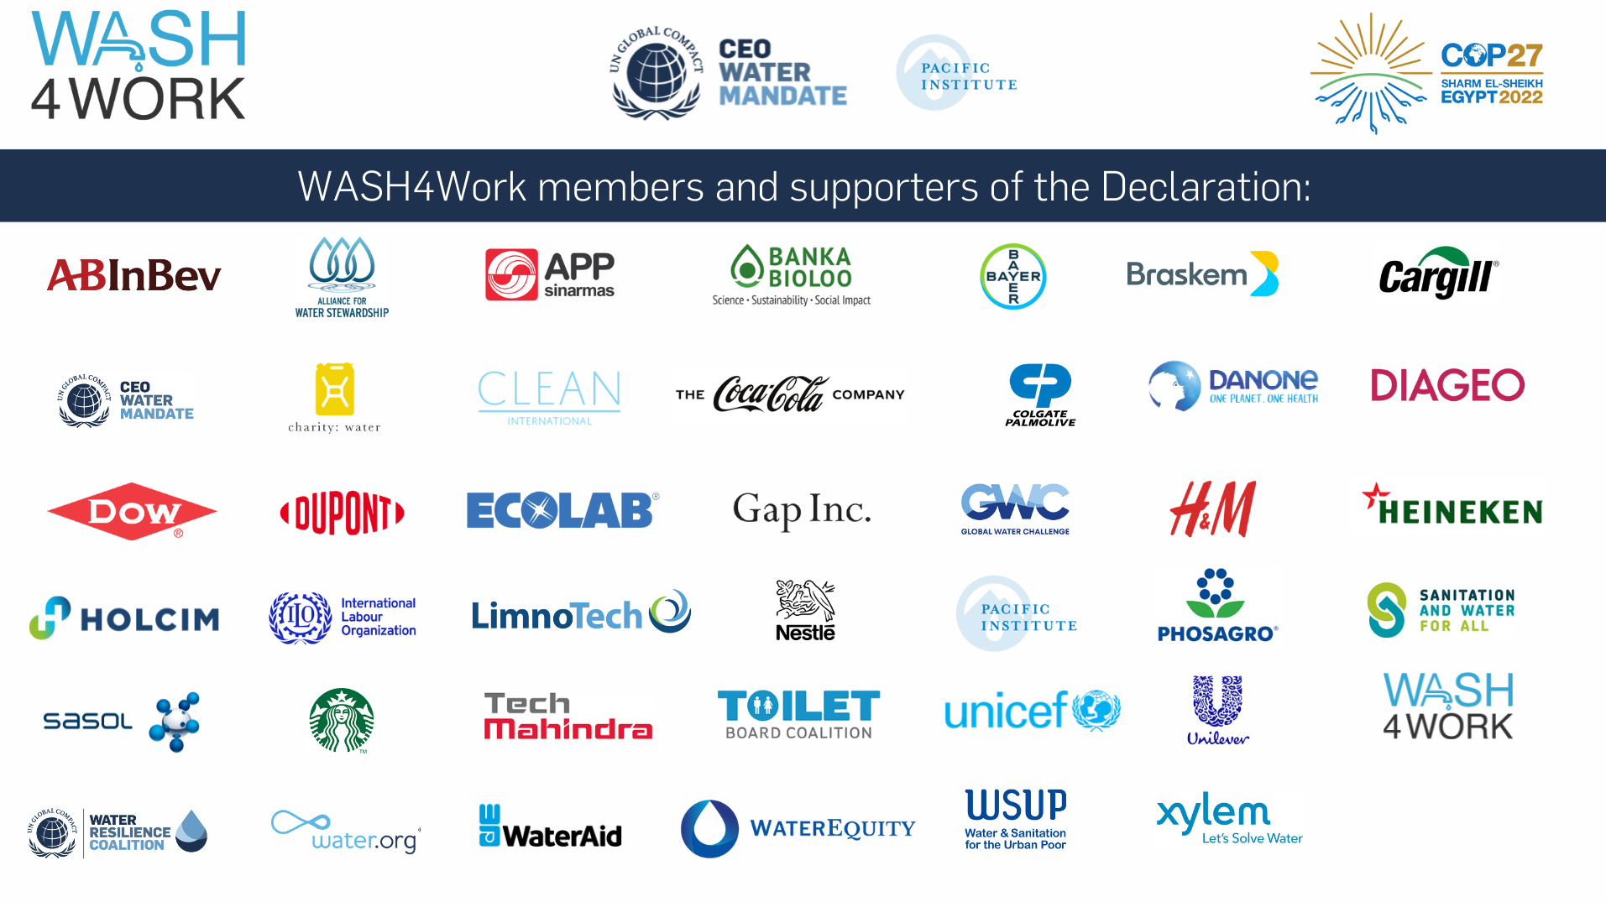
Business Declaration on Climate Resilient WASH
Notes:
AT the COP27 global climate conference in Nov 2022 27 companies joined wash expert stakeholders to launch the business declaration – demonstrating consensus on the evolution of leading practice standards.

Slide 10
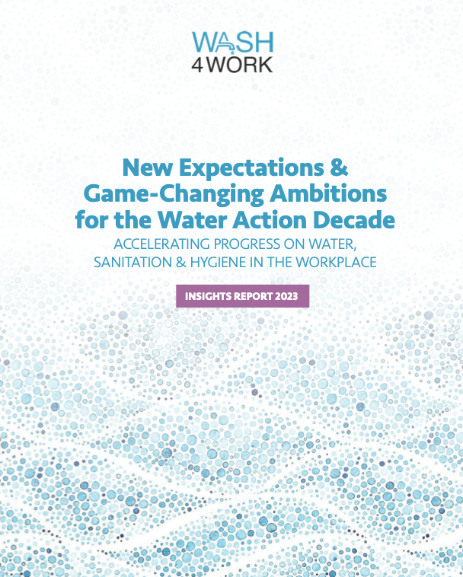



Insights Report 2022
For Release February 2023
New Expectations & Game-Changing Ambitions for the Water Action Decade
Accelerating Progress on Water, Sanitation & Hygiene in the Workplace
Notes:
We have captured our learnings from 2022 in a new report to be released in February
In the next 3 slides we share highlights of the key messages

Slide 11
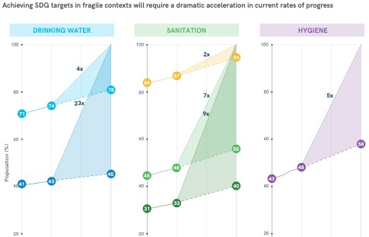
Global WASH
Outlook 2023
Size of the global WASH ACCESS gap
4X+ Acceleration required to meet 2030 SDG6 Goals
WHO/UNICEF JMP 2020
Notes:
In 2023 global governments and stakeholders will come together on the important occasion of UN Water Conference
and the expectations are high to forge much more ambitious commitments to game changing actions for the water action decade to 2030.
It is recognized that progress on the global goals to achieve universal access to safely managed and climate resilient water, sanitation and hygiene (WASH) still lag behind 2030 targets and that at least a 4x acceleration will be required to reach basic access - according to the JMP 2020 – and even higher rates of acceleration for safely managed water snitation and hygiene
There are now higher expectations on business to bring climate resilient solutions, to increase investments, and to extend corporate responsibility, traceability and accountability for WASH access beyond workplace operations to supply chains and employee homes and communities.

Slide 12
WASH & Corporate
Water Stewardship in 2023
  WASH risks for business increasing
  Price of WASH risks $6 BN – 10 companies (CDP)
  Business case for WASH stronger
  Financial ROI of WASH for business
  $1.32-$2.05 – to $5.11-$9.04 averaged return – for every $1 invested (WaterAid)
Notes:
What is the status of WASH acess from a business prespective in 2023?
More businesses are recognizing their exposure to
Unsafe and unreliable drinking water, sanitation and hygiene services for workers at work or at home, and the material impacts on business continutity and growth,
via productivity losses, security of business-critical raw materials, in addition to potential reputation, trust and license to operate risks.
And that Climate change is already disrupting the quality and quantity of water supplies and the sustainability of sanitation and hygiene behaviors, especially for the most vulnerable. Setting back progress, causing need for re-investment.
New mandatory sustainability reporting laws such as the EU CRBD now in place in 2023, are increasing pressure on businesses to provide more disclosure on exposure to risks due to lack of access to WASH and the actions businesses are taking to mitigate these risks. The price of WASH risk has been calculated at $6 Billion amongst just 10 global companies (CDP 2022). It is expected that new reporting and disclosure requirements will lead to increased investor pressure as well.
----------------
However, the business case for investing in WASH is also getting stronger.
The business benefits of ensuring WASH access are starting to be more defined; going beyond basic compliance to un-lock multiple benefits. Important links are being made on how WASH access can contribute to corporate water stewardship commitments to improved water quality and quantity; and corporate sustainability goals including gender equality, improved health and well-being, education, climate resilience and economic opportunities for communities.
There is new evidence of financial returns for the business on WASH investments as well. A study released in 2022 by WaterAid revealed proof of positive returns in the form of increased productivity, reduced absenteeism and overall health improvements. For every $1 invested overall delivered between $1.32-$2.05 averaged return – and $5.11-$9.04 on the high end.

Slide 13
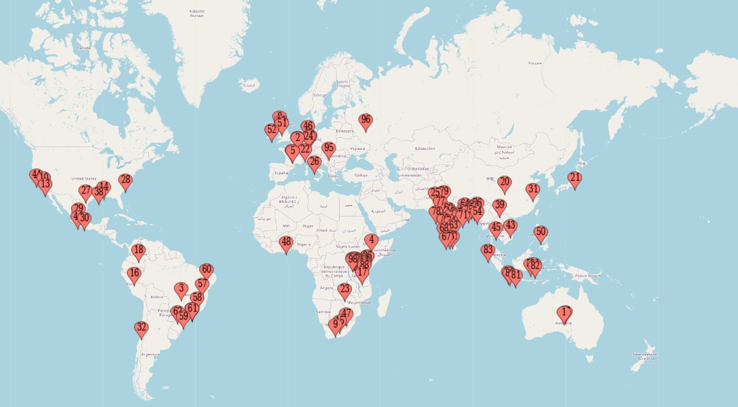
2023
Outlook
MEASURING PROGRESS
WASH in the Workplace, Supply Chains
& Communities
WaterActionHub.org
Notes:
Businesses have a unique opportunity to change the game and close the gap on WASH access through the broad reach and influence of their workforces and supply chains. Yet business achievements on WASH access are currently not accounted for in the WHO/UNICEF joint monitoring program measuring progress on SDG 6. Measuring collective business progress on WASH in the Workplace through a standardized reporting method can demonstrate business contributions to closing the 4x+ acceleration gap.
In 2023 the WASH4Work program will focus on supporting businesses for these important shifts in new expectations and game-changing ambitions for water, sanitation and hygiene access in the water action decade to 2030.

Slide 14
Work Program
2023
  WASH Benefits Accounting Method
  Climate Resilient WASH
  WASH in the Supply Chain
Notes:
The 2023 work program will deepen its work to support companies in achieving WASH goals and commitments, with standardized reporting tools, guidance for climate resilient WASH program implementation, building community resilience, and support to broaden WASH access across supply chains.
In this next part of the meeting we will review the plans for our work in 2023 highlighting opportunities for you to engage.
The WASH Benefits Accounting Method – which will be launched
- Launch, Guidance, Pilots
Climate Resilient WASH
- Guidance, Input to NPWI, Pilots (WRC Collective Actions)
WASH in the Supply Chain
- Vision, Supplier Support Program, Collective Supplier Actions

Slide 15
2023
Standardized wash benefits accounting method
Launch at UN Water Conference – March 2023
Pilot the method with member companies
Develop guidance document
Align method with corporate water stewardship & WASH disclosure and reporting
Advocate for broad business use
Notes:
We will launch the standardized WASH benefits accounting method at the UN water Conference – to be piloted by W4W member companies in 2023 as we develop a guidance document for implementation and use.
We will also

Slide 16
Nate Jacobson
Limno Tech
WASH BENEFITS ACCOUNTING METHOD

Slide 17
2023
Climate resilient wash
Business framework
Develop implementation guidance document
Align with corporate water stewardship, NPWI & WASH stakeholders
Pilot the method via collective action projects
Advocate for broad business use
Notes:
We will move forward our work on understanding and implementing new global expectations for climate resilient WASH - from the COP27 Business Declaration launched in Nov22 – to the development of implementation guidance – in partnership with WASH expert stakeholder members.
There is also an opportunity to pilot the climate resilient wash framework via collective action projects – we will hear next from WRC a current opportunity.

Slide 18
Andre Ramalho
Water Resilience Coalition
WASH COLLECTIVE ACTIONS

Slide 19
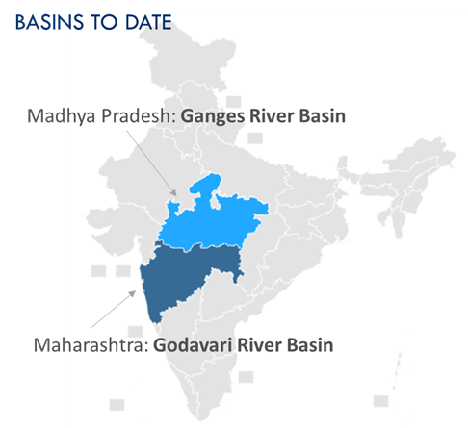
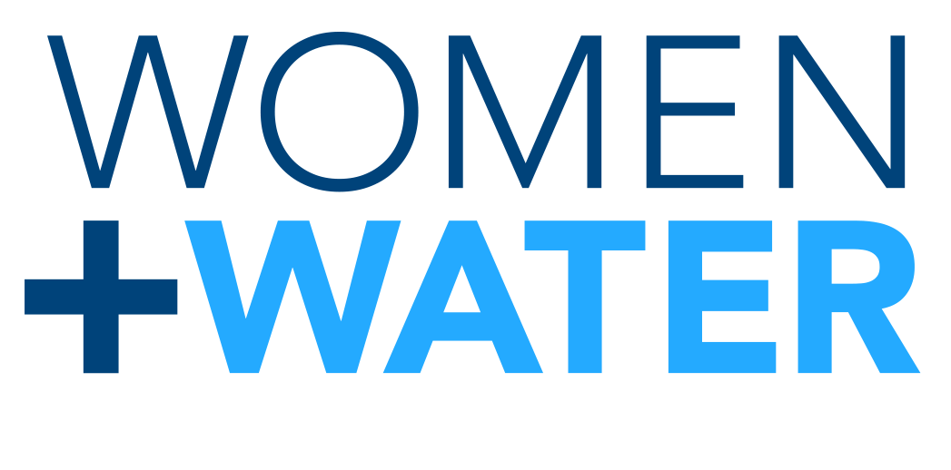
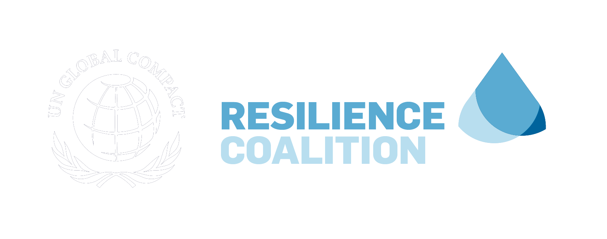
SCALING WOMEN+WATER IN INDIA VIA COLLECTIVE ACTION
A private sector-led partnership to improve access to climate-resilient clean water & sanitation for 5-10 million people by 2030
Since 2017, USAID & Gap Inc.’s Women + Water Alliance has empowered 2 million people to improve their access to clean water & sanitation
WASH interventions led by WaterAid & Water.org
Current program ends in January 2023
W+W program framework ready to be scaled in new geographies in India with new partners through corporate collective action
Notes:
WaterAid
Hi everyone. My name is Gillian Winkler and I am a Director of Partnerships for WaterAid America, based in New York. Thanks again to WASH4Work and you all for having us hear today to share more about this high impact opportunity.
WaterAid has been engaged by the Water Resilience Coalition and Gap, Inc. to facilitate the current design phase for the next iteration of Women+Water in India as a private sector-led collective action partnership. As many of you know, USAID and Gap have been partnering on the Women+Water Alliance since 2017 to improve and sustain the health and well-being of women and communities touched by the apparel industry in India. With WaterAid and water.org leading implementation of Women+Water’s WASH strategy, the alliance has reached over 2 million people in Madhya Pradesh and Maharashtra. With the USAID partnership formally ending in January of next year, there is a clear opportunity to scale its impact by bringing together corporates with the shared interest of expanding water security in additional geographies within the key market of India, as well as excellent potential for other public funders to get involved.

Slide 20
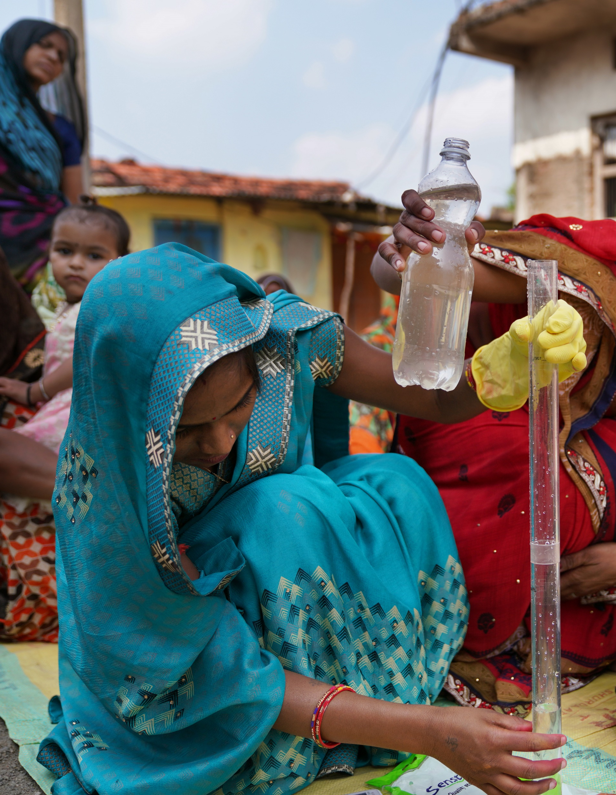
THE PROGRAM IN INDIA
Objectives
Improve demand for and supply of WASH in common priority basins in India
Center women as key change agents for WASH within their communities
Align with and leverage Government of India and multilateral investment in WASH to unlock additional funding
Deliver co-benefits: replenishment, women’s empowerment, economic empowerment, community resilience to climate change impacts
Approach
Building women and community capacity to engage with government for WASH planning
Strengthening local water governance and management
Catalyzing access to WASH financing through microfinance and public investment
Notes:
The next phase of the program will build on the extensive efforts and successes of the existing alliance. Led by an aligned group of corporate stakeholders, it will highlight the role and influence of the private sector in making transformative impact on WASH, addressing the “s” of water stewardship within ESG strategies.
The India program design will be further refined in the coming months; as part of the current design stage, we are seeking feedback from interested companies to understand their priorities and existing programming so as to align the program as much as possible to the broadest group of corporate stakeholders. However, we expect the scale up to reflect the key objectives outlined here:
Improve demand for and supply of WASH in common priority basins in India
Center women as key change agents for WASH within their communities
Align with and leverage Government of India and multilateral investment in WASH to unlock additional funding; partnership is being designed and positioned as a private sector partnership, but we also seek to bring USAID and others like UNICEF to the table
Deliver co-benefits. While the primary results of the scale-up will be centered on WASH access, we expect the program to deliver measurable benefits around replenishment, women’s empowerment, economic empowerment, and community resilience to climate impacts
The general intervention approach will incorporate activities to
Build women and community to engage government in WASH planning – for example, supporting community groups to develop village action plans to unlock public funds and resources for new or improved infrastructure
Strengthen local water governance and management by engaging local and state-level stakeholders – for example, working with government officials, and training youth and women in water quality monitoring and operations and maintenance of water systems
Catalyze access to WASH financing through microfinance and public investment – for example, building financial products and making it easier for households to access financing to implement their own WASH solutions
In addition, while the current alliance does not involve hardware installation due to USAID regulations, we are considering incorporating direct implementation of WASH infrastructure as part of this scale up program.
[If asked: To reach 10M people, we estimate funding of ~$65M+ will be required. The results of the design phase will inform a final detailed budget for the partnership implementation phase. The final cost will be influenced by several factors, including the number/location of target geographies, communication requirements, the number of funding partners, the governance structure, and currency risk and inflation projections.
The programmatic foundation is in place, as is the implementation capacity, relationships, and proven models. What’s missing is the funding. What’s ultimately achievable depends on how many companies are willing to make the investment and at what level of investment.]

Slide 21
2023
WASH in the supply chain
Develop a leading practice vision
Identify baseline size of the gap
Identify supply chain / supplier overlap for collective action projects
Develop supplier support program
Notes:
WASH in the Supply Chain
- Vision, Supplier Support Program, Collective Supplier Actions
Through a consultation conducted amongst members in 2022, participating members suggested that we develop a new leading practice vision for WASH IN THE SUPPLY CHAIN to encourage and help mobilize increased actions on WASH across supply chains which has been an ongoing challenge.
In addition WASH for work will support this work by identify a baseline by country on the size of the gap, and overlay member supply chain overlap to identify priorities for potential collective actions.
And we will continue to develop a support program for suppliers starting on their WASH implementation journey.

Slide 22
2023
BASLINE SIZE OF THE GAP & SUPPLY CHAIN OVERLAP
WASH in the Workplace, Supply Chains
& Communities
WaterActionHub.org
Notes:
W4w is currently
MAPPING THE SIZE OF THE WASH GAP by country & CORPORATE SUPPLY CHAIN EXPOSURE
TO IDENTIFY COLLECTIVE PRIORITIES / ACTIONS / TARGETS
And to serve as a baseline for measuring collective progress

Slide 23
2023
PRACTICAL ACTIONS
FOR BUSINESS
Integrate climate-resilient WASH considerations into WASH programs and investments
Integrate WASH access leading practice requirements into supplier contracts and codes of conduct
Align WASH access measurement and reporting with the Standardized WASH Benefits Accounting Method
Share annual progress reports – to enable monitoring of collective business contributions to SDG 6
Notes:
How can your company engage in leading practice in 2023?
Integrate climate-resilient WASH considerations into WASH programs and investments via WASH4Work Business Framework on Climate Resilient WASH guidance
Integrate WASH access leading practice requirements into supplier contracts and codes of conduct
Align WASH access measurement and reporting with the Standardized WASH Benefits Accounting Method
Share annual progress reports with WASH4Work utilizing the Standardized WASH Benefits Accounting Method to enable monitoring of collective business contributions to SDG 6 joint monitoring program under new sub-section “Status of WASH in the Workplace”

Slide 24






2023 Communications & Events
WORLD WATER WEEK
WORLD TOILET DAY
COP28
FULL PARTNER MEETING
31 JAN 2023
NYC
STOCKHOLM
19 NOV
DUBAI
22-24 MAR
20-24 AUG
30 NOV – 12 DEC
JAN
MAR
AUG
NOV
DEC
Standardized Accounting Method for the Co-Benefits of WASH: Launch
WASH in the Supply Chain:
Vision & Leading Practice Guidance
Climate-Resilient WASH:
Business Framework & Guidance

Slide 25

2023
New York
21-24 March 2023
Expectations:
Game changing Partnerships,
Commitments & Action
Dramatically accelerate the speed and scale of solutions
March 21: Evening Reception
Launch of WASH Benefits Accounting Method
March 23/24: Practitioner Workshop
Applying the WASH Benefits Accounting Method

Slide 26
Mai-Lan Ha
CEO Water Mandate
UN WATER CONFERENCE 2023

Slide 27
Membership & Engagement
Benefits for MEMBERS
  Recognized for WASH actions & contributions to SDG6
  Direct access to leading practice via corporate peers and WASH expert organization members
  Support for corporate water stewardship commitments to WASH access

Slide 28
How to Engage
for MEMBERS & ceo water mandate endorsers
  Automatically receive WASH4Work engagement communications
  Join working groups to connect with experts, practitioners and leading practice
  Share logo / use WASH4Work supporter logo for recognition of WASH actions & commitments

Slide 29
Annual Membership Fee
Structure
Support the secretariat
Corporate Members: $3,000.00/year from CEO Water Mande Endorser contribution
Suppliers: $1,000.00/year
Non-Corporate Partners: $1,500.00/year or equivalent in-kind support

Slide 30


Contact us to Engage!
secretariat@wash4work.org
wash4work.org
@WASH4Work
/in/wash4work/

